Slide 1
The Minimum Standards for Child Protection in Humanitarian Action
CPMS
SLIDE DECK
Notes:
Facilitators:
This briefing is for any potential user of the CPMS. It is geared primarily toward child protection staff, so consider broadening some questions or providing more detail, if colleagues from other sectors join you.
It is assumed that the group is about 20 people and that everyone in the room knows each other (perhaps colleagues from your agency or the CP coordination group). if not, add 5 minutes for quick introductions.
PREPARE: a flipchart with the objectives of the session
By the end of the session, participants will be able to:
Describe the content of Standard 6
Explain & Share its key messages
Demonstrate how & why to use the handbook
NOTE: if you have already done a Session on Pillar(s), Principles or other Standard(s), skip slide 2 & 8
TIP: Slides are animated -> for each click you’ll make, some few words, a title or an image will appear on the slide.
Read the corresponding notes from the facilitators notes, before showing the following content, so participants have time to process what you say, and read each point.

Slide 2
Aim of the Standards
Benchmark for CPHA.
Collaborative, inter-agency tool
Links with Core Humanitarian Standard
Contextualisation for local ownership
Purpose:
quality and accountability
impact for children’s protection and well-being
Notes:
Donors, local governments, colleagues in other sectors and our beneficiaries themselves want to know what we are doing and why. The CPMS are our benchmark. They are the key way to operationalise or make real children's rights in the practice of humanitarian response.
They are a collaborative, inter-agency tool, that links with other initiatives, such as the Core Humanitarian Standard, INSPIRE and the Humanitarian Inclusion Standards
Wherever relevant, the CPMS align with INSPIRE’s 7 strategies to end violence against children – initiative’s icons are actually scattered through the text. In addition, the Core Humanitarian Standard on Quality and Accountability is highlighted in the Introduction and resonates throughout the handbook.
Contextualisation (adaptation to your specific context) is encouraged and can create ownership of the standards at every level. It builds a deeper understanding of child protection in the specific context for a wide range of actors. National coordination groups are therefore encouraged to adapt the CPMS. Please raise it with colleagues locally and then seek the guidance of the global CPMS team. For more information, watch the contextualization video on the Alliance’s youtube channel.
BOX: The CPMS aim at improving the quality and accountability of our programing and increasing impact for children’s protection and well-being in humanitarian action (across all contexts), by establishing common principles, evidence, prevention and goals to achieve. They provide a synthesis of good practice and learning to date.

Slide 3
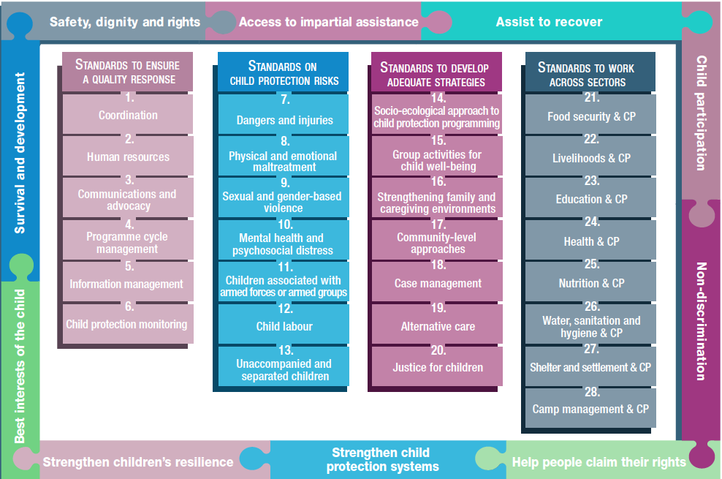
Overview
Notes:
This is an overview of the CPMS structure: there are 28 Standards across 4 pillars and 10 CPHA principles threaded throughout.
You can find this overview on the back of the CPMS handbook or in the online handbook; it’s a practical way of locating quickly a specific topic.
This presentation focuses on Standard 6: Child Protection Monitoring

Slide 4
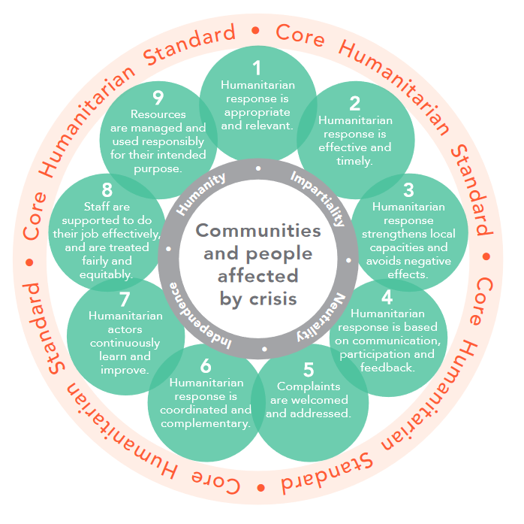
General intro to Standard 6
Part of Pillar 1 related to quality response
To be used w/ Standards (7–28) & the CPMS principles
CHS & Child Protection Analytical Framework
CP risks, violations and capacities
Purpose
Secondary Data collection
What can you inform and influence with it?
Notes:
This Standard is part of the first Pillar of Standards related to quality response, which are all common across all areas of child protection programming, applicable in all situations and contexts, during preparedness and response phases. They are ALL fundamental to reach the level of quality we are aiming to reach as practionners.
These Quality standards should be used in conjunction with all the rest of the Standards (7–28) & the CPMS principles
This Standard is complementary to the Core Humanitarian Standard on Quality and Accountability (CHS),as a whole, and to the Child Protection Analytical Framework, and should be used together with them.
DEF: Child protection situation monitoring refers to the regular and systematic examination (monitoring) of child protection risks, violations and capacities in a specific humanitarian context.
The purpose is to produce situational evidence on child protection risks and existing response capacities to inform and adapt the response. Response monitoring is the ongoing and coordinated measurement of the humanitarian response in a humanitarian context, i.e. activities planned and carried out by humanitarian actors.
The collection, management, analysis and use of CP monitoring must be done in a principled, safe and collaborative manner.
Secondary data is any information taken from existing sources of information such as reports, assessment data, case management data, etc. Through a mix of quantitative and qualitative information sources, a preliminary situation analysis of child protection needs and capacities can be generated. A secondary data review can help identify existing data and information, potential gaps and appropriate methods for addressing those gaps.
This Standard links especially with the approach of prevention, intending to mitigate any risks to children and their families when collecting, processing and keeping records [→ the prevention icon]
Discussion Prompt: What can you inform and influence with it?
->Child protection monitoring informs and influences:
Prevention and response activities at individual, family and community levels;
Advocacy that respects, protects, promotes and fulfils the rights of children as outlined in relevant national and international laws and resolutions; and
Priority-setting so that interventions address children’s most serious protection risks and gaps.

Slide 5
PIM principles:
People-centred and inclusive;
Do no harm;
Defined purpose;
Informed consent/assent and confidentiality;
Data responsibility, protection and security;
Competency and capacity;
Impartiality; and
Coordination and collaboration.
“Objective and timely data and information on child protection risks are collected, managed, analysed and used in a principled, safe and collaborative manner to enable evidence-informed prevention and response actions.”
Notes:
Standard 6 states: “Objective and timely data and information on child protection risks are collected, managed, analysed and used in a principled, safe and collaborative manner to enable evidence-informed prevention and response actions.”
The design, implementation and evaluation of child protection monitoring systems should follow the PIM principles:
People-centred and inclusive;
Do no harm;
Defined purpose;
Informed consent/assent and confidentiality;
Data responsibility, protection and security;
Competency and capacity;
Impartiality; and
Coordination and collaboration.
These principles must be applied in addition to the CPMS Principles.

Slide 6
Child protection monitoring system
WHAT DO YOU NEED?
Purpose
Sources of information
Contextualised, culturally appropriate indicators
Roles, responsibilities and methodologies
Potential risks
Sharing protocols
Referral processes
KEEP IN MIND
Secondary trauma
Best interests of the child
Under/over-reporting
Ethics, principles and good practices, especially Do no harm
Notes:
WHAT DO YOU NEED to establish a Child Protection system?
Define the purpose of the child protection monitoring system and the information to be collected.
Map and assess existing sources of information.
Define a common set of contextualised, culturally appropriate indicators before beginning primary data collection.
Collaborate with other child protection actors, humanitarian sectors and stakeholders (including children) to identify and agree upon roles, responsibilities and methodologies for child protection monitoring, including child-led options.
Assess and mitigate the potential risks to children, families and communities during data collection, processing and storage.
Establish safe, responsible, purposeful and harmonised protocols for sharing information between relevant stakeholders.
Establish effective, timely and appropriate information sharing, referral processes, reporting schedules and templates for child protection monitoring that avoid duplication and minimise reporting burdens.
KEEP IN MIND:
staff who monitor child protection concerns can develop secondary trauma – we have to remember to provide them with psychosocial support to mitigate that
the best interests of the child and the informed consent/assent of children and/or caregivers when collecting information always have to be prioritized
under-reporting (the percentage of cases not reported) or over-reporting (cases reported multiple times) are possible and to estimate and/or analyse
ethics, principles and good practices are key in managing information. (See Principles and Standard 5). The principle of Do Not harm should ALWAYS guide what we do! Child relevant and purposeful participation should not be forgotten when conducting monitoring.
-------------**------------------
Facilitator: If pertinent to your context, you can also mention & discuss here the MRM mechanism & protocols:
developed by the Country Task Force for Monitoring and Reporting on grave violations against children
DEF: systematic and comprehensive mechanism (MRM) to provide timely, objective, accurate and reliable information on six grave violations against children committed in situations of armed conflict (or situations of concern). The violations monitored by the MRM are:
- Killing and maiming of children;
- Recruitment and use of children in armed forces or armed groups;
- Attacks on schools and hospitals;
- Rape and other forms of sexual violence against children;
- Abduction of children; and
Denial of humanitarian access to children.
The MRM provides this information to enhance the accountability and compliance of parties to conflict. The MRM does not provide the total number of grave violations committed against children. The MRM should be implemented by specialised actors with the ability to report and verify according to MRM standards.

Slide 7
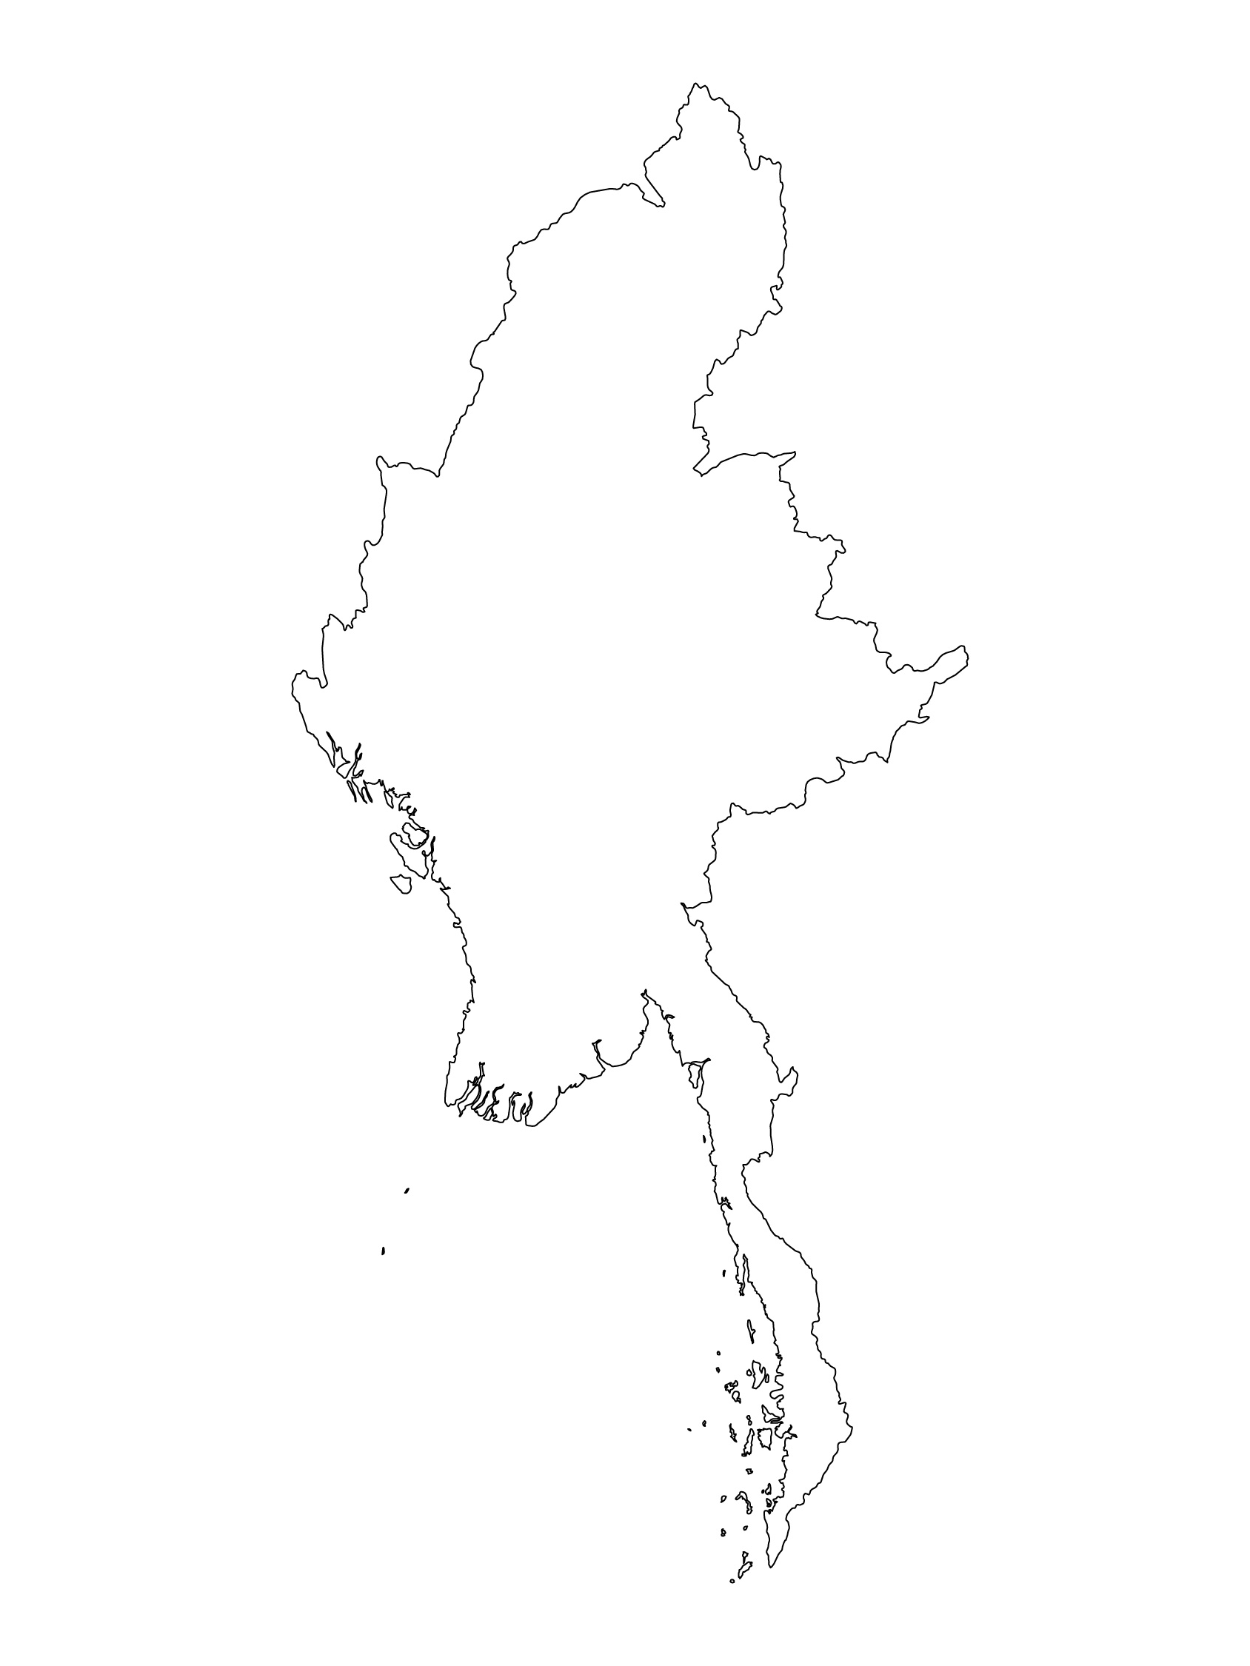
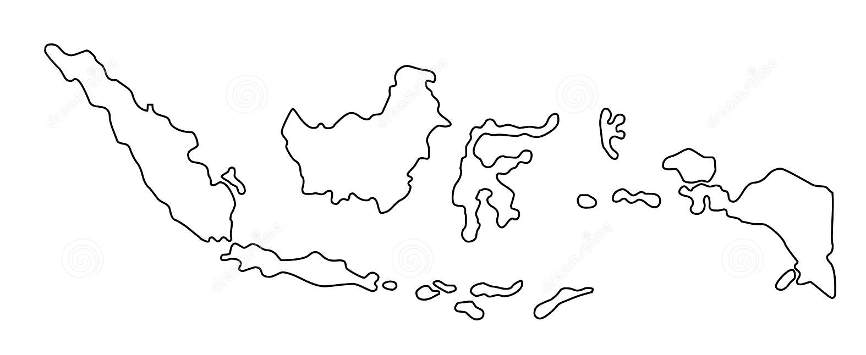
Examples from the Region
[COUNTRY NAME]
Add key presentation sentence about a specific program/project using Standard 6
Add name of organisations
Add key message / numbers
[ COUNTRY NAME]
Add key presentation sentence about a specific program/project using Standard 6
Add name of organisations
Add key message / numbers
[ COUNTRY NAME]
Add key presentation sentence about a specific program/project using Standard 6
Add name of organisations
Add key message / numbers
Notes:
Depending on the time you have for facilitation, consider adding here examples from the Region/ Country/ Response, of programming that meets the standards.
This could be a draft slide that you could update or remove if necessary.
For each example, you could add:
A short, concise, key presentation sentence about the specific program/project using Standard 6
Add the name of organisations and partners involved
Add practical lessons learnt, key actions, message or numbers, that will attract interest of your audience
Another option, if you have longer (and also depending on the audience you have), this slide can be completed in an interactive way during the session.
In that case, you could:
split the groups into 2 or 3 smaller groups,
allow 15 – 20 min for them to prepare a short presentation of an example from the Region/ Country/ Response, of programming that meets the standard
in plenary, have the groups present their examples, and discuss /compare lessons learnt out of them.
If you will be sending this presentation to the participants after the training, you can fill up this slide, to keep records of the presentations.
TIP: you can use https://thenounproject.com/ to get map outlines like those.

Slide 8
Need more than the hard copy?
On the Alliance website
PDF version
Briefing & Implementation Pack
25-page Summary
E-course
YouTube videos
A gallery of illustrated Standards
👉 www.AllianceCPHA.org
On the Humanitarian Standards Partnership website
Online, interactive version
HSP App for mobile phones and tablets
👉 www.HumanitarianStandardsPartnership.org
Notes:
[Facilitators - if you can project from the internet, then we suggest you navigate people there and show them]
HSP:
1. Online handbook
2. The Humanitarian Standards Partnership App
– It is the 2nd most popular app on that site after Sphere
CPMS page:
1. Interactive handbook – our greatest resource
2. A Summary: At just 32 pages, it means that it is very topline but can be used to introduce the idea of minimum standards or start child protection discussions with government colleagues or other humanitarians without overwhelming them with the huge handbook.
Alliance website:
The PDF & all materials available can be downloaded if people want to print just portions of the CPMS, on the Alliance site
The “Introduction to CPMS” Briefing Pack contains this PPT and facilitation notes, plus the 2 page Introduction handout.
A gallery of illustrated Standards
Discover our free CPMS e-course with a range of modules
Videos on the Alliance Youtube channel
ASK: What should our next steps as a team/agency/individual be?
(i.e. you might schedule a longer meeting to digest the changes and create a plan; or ask colleagues to present certain new/revised standards and their implications for the programme; or set up a training or ask Senior Management for a meeting to discuss accountability to children, etc)
[Facilitators - Printed copies – there is a small stockpile of the Handbook and Summary that the global Alliance has in Geneva; however, countries and regions are encouraged to print & manage their own copies locally. Usually, this would be done through the inter-agency Coordination structure. On request, the Alliance can share a print-ready PDF.]
Thank you so much for coming together and starting to explore the CPMS. I will follow up on the next steps we discussed. And that’s the key – the CPMS is a gift that just keeps on giving every time you open it!

