Slide 1
The Minimum Standards for Child Protection in Humanitarian Action
CPMS
SLIDE DECK
Notes:
Facilitators:
This briefing is for any potential user of the CPMS. It is geared primarily toward child protection staff, so consider broadening some questions or providing more detail, if colleagues from other sectors join you.
It is assumed that the group is about 20 people and that everyone in the room knows each other (perhaps colleagues from your agency or the CP coordination group). if not, add 5 minutes for quick introductions.
PREPARE: a flipchart with the objectives of the session
By the end of the session, participants will be able to:
Describe the content of Standard 2
Explain & share its key messages
Demonstrate how & why to use the handbook
NOTE: if you have already done a Session on Pillar(s), Principles or other Standard(s), skip slide 2 & 7
TIP: Slides are animated -> for each click you’ll make, some few words, a title or an image will appear on the slide.
Read the corresponding notes from the facilitators notes, before showing the following content, so participants have time to process what you say, and read each point.

Slide 2
Aim of the Standards
Benchmark for CPHA.
Collaborative, inter-agency tool
Links with Core Humanitarian Standard
Contextualisation for local ownership
Purpose:
quality and accountability
impact for children’s protection and well-being
Notes:
Donors, local governments, colleagues in other sectors and our beneficiaries themselves want to know what we are doing and why. The CPMS are our benchmark. They are the key way to operationalise or make real children's rights in the practice of humanitarian response.
They are a collaborative, inter-agency tool, that links with other initiatives, such as the Core Humanitarian Standard, INSPIRE and the Humanitarian Inclusion Standards
Wherever relevant, the CPMS align with INSPIRE’s 7 strategies to end violence against children – initiative’s icons are actually scattered through the text. In addition, the Core Humanitarian Standard on Quality and Accountability is highlighted in the Introduction and resonates throughout the handbook.
Contextualisation is encouraged and can create ownership of the standards at every level. It builds a deeper understanding of child protection in the specific context for a wide range of actors. National coordination groups are therefore encouraged to adapt the CPMS. Please raise it with colleagues locally and then seek the guidance of the global CPMS team. For more information, watch the short contextualization video on the Alliance’s youtube channel.
BOX: The CPMS aim at improving the quality and accountability of our programing and increasing impact for children’s protection and well-being in humanitarian action (internal displacement and refugee contexts), by establishing common principles, evidence, prevention and goals to achieve. They provide a synthesis of good practice and learning to date.

Slide 3
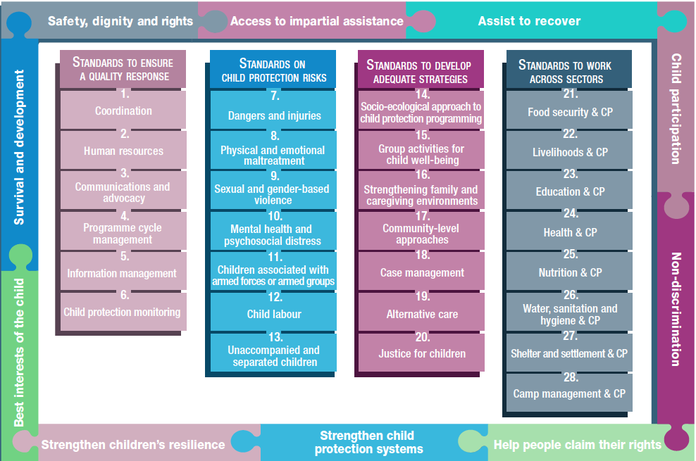
Overview
Notes:
This is an overview of the CPMS structure: there are 28 Standards across 4 pillars and 10 CPHA principles threaded throughout.
You can find this overview on the back of the CPMS handbook or in the online handbook; it’s a practical way of locating quickly a specific topic.
This presentation focuses on Standard 2: Human Resources

Slide 4
General intro to Standard 2
Part of Pillar 1 related to quality response
To be used w/ Standards (7–28) & the CPMS principles
Commitment 8 of the CHS
Skills and expertise needed
HR processes, procedures and policies
Safeguarding
Who is concerned by safeguarding policies?
Notes:
This Standard is part of the first Pillar related to quality response, which are common across all areas of child protection programming, applicable in all situations and contexts, during preparedness and response phases. They are ALL fundamental to reach the quality we are aiming for as practioners.
These Quality standards should be used in conjunction with all the rest of the Standards (7–28) & the CPMS principles
This Standard is complementary to the Core Humanitarian Standard on Quality and Accountability (CHS), and should be used with it. More specifically, it links with Commitment 8, which describes the need to support staff to do their jobs effectively and to treat staff fairly and equitably.
Communities and people affected by crisis receive the assistance they require from competent and well-managed staff and volunteers.
Quality Criterion: Staff are supported to do their job effectively, and are treated fairly and equitably.
This standard aims at ensuring that child protection services are delivered by staff and associates who have proven competence in their areas of work & have developed the skills and expertise needed to do their work
It puts a focus on HR processes, procedures and policies that promote measures to protect children and community members from maltreatment and harm by humanitarian workers: all organisations should have a ‘child safeguarding’ or ‘child protection’ policy, procedures and an implementation plan that seek to prevent staff, operations or programmes from harming children. They also need to implement simple, accessible, child-friendly, anonymous programme feedback and reporting mechanisms at each project site.
[→ the safeguarding icon]
Discussion Prompt: who is concerned by safeguarding policies?
-> All staff and associates who provide child protection services (including volunteers, incentive workers, contractors, consultants, partners and anyone else associated with or representing your organisation)

Slide 5
“Child protection services are delivered by staff and associates who have proven competence in their areas of work and are guided by human resources processes and policies that promote equitable working arrangements and measures to protect children from maltreatment by humanitarian workers.”
Does not replace other safeguarding standards
Processes:
Human resources plan
Deployment capacity
CoC
Advocacy and awareness
Induction
Learning
Feedback and reporting mechanism
Working environment
Notes:
Standard 2 states : “Child protection services are delivered by staff and associates who have proven competence in their areas of work and are guided by human resources processes and policies that promote equitable working arrangements and measures to protect children from maltreatment by humanitarian workers.”
This standard does not replace other safeguarding standards the organization might have put in place
Example of processes covered by the standard:
Emergency preparedness human resources plan (to ensure rapid recruitment and training and avoid weakening the staffing structures)
Rapid deployment mechanisms & global and regional standby personnel
Code of conduct, disciplinary, grievance, non-harassment and non-discrimination policies
Indicators and processes for monitoring organizational diversity & inclusion (safe recruitment; non-discriminatory interview panels; hiring and fairly compensating beneficiaries of programs, including refugees, internally displaced persons, migrants and stateless persons, etc.)
Induction processes
Learning, capacity-building plans, training for staff and associates
Organisational safeguarding feedback and reporting mechanism that is accessible to all children, staff, associates and community members
Well-being & stress management to create a healthy working environment
Capacity needs assessment & strengthening, using CPHA Competency Framework

Slide 6
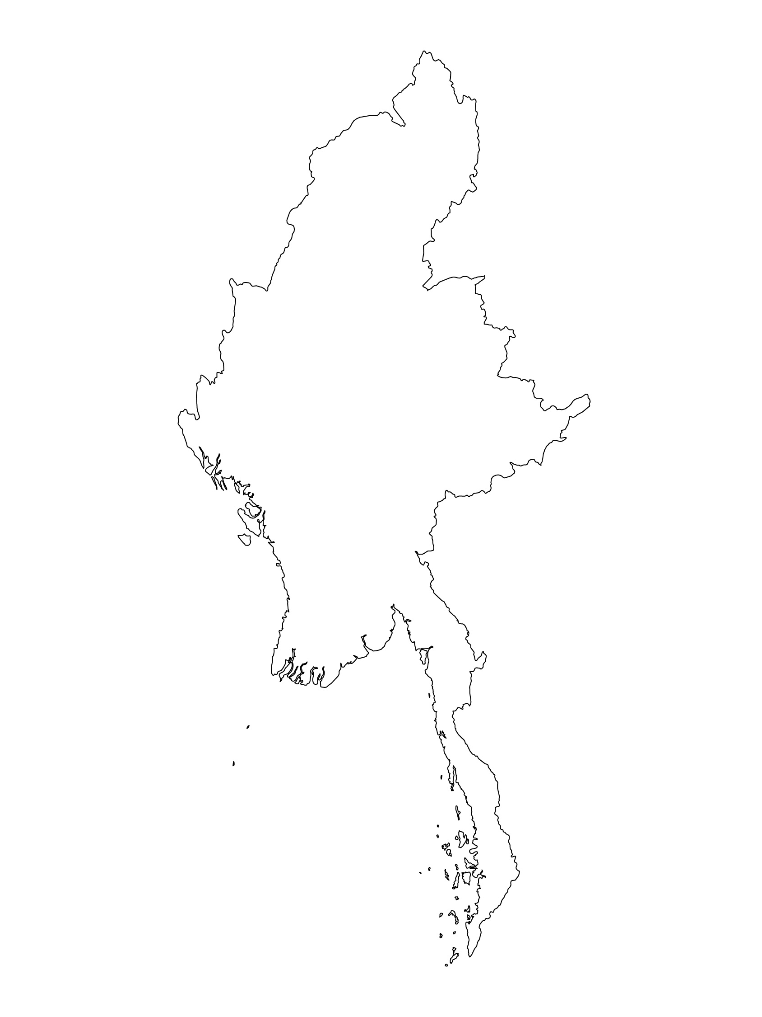
Examples from the Region
[COUNTRY NAME]
Add key presentation sentence about a specific program/project using Standard 2
Add name of organisations
Add key message / numbers
[ COUNTRY NAME]
Add key presentation sentence about a specific program/project using Standard 2
Add name of organisations
Add key message / numbers
[ COUNTRY NAME]
Add key presentation sentence about a specific program/project using Standard 2
Add name of organisations
Add key message / numbers
Notes:
Depending on the time you have for facilitation, consider adding here examples from the Region/ Country/ Response, of programming that meets the standards.
This could be a draft slide that you could update or remove if necessary.
For each example, you could add:
A short, concise, key presentation sentence about the specific program/project using Standard 2
Add the name of organisations and partners involved
Add practical lessons learnt, key actions, message or numbers, that will attract interest of your audience
Another option, if you have longer (and also depending on the audience you have), this slide can be completed in an interactive way during the session.
In that case, you could:
split the groups into 2 or 3 smaller groups,
allow 15 – 20 min for them to prepare a short presentation of an example from the Region/ Country/ Response, of programming that meets the standard
in plenary, have the groups present their examples, and discuss /compare lessons learnt out of them.
If you will be sending this presentation to the participants after the training, you can fill up this slide, to keep records of the presentations.
TIP: you can use https://thenounproject.com/ to get map outlines like those.

Slide 7
Need more than the hard copy?
On the Alliance website
PDF version
Briefing & Implementation Pack
25-page Summary
E-course
YouTube videos
A gallery of illustrated Standards
👉 www.AllianceCPHA.org
On the Humanitarian Standards Partnership website
Online, interactive version
HSP App for mobile phones and tablets
👉 www.HumanitarianStandardsPartnership.org
Notes:
[Facilitators - if you can project from the internet, then we suggest you navigate people there and show them]
HSP:
1. Online handbook
2. The Humanitarian Standards Partnership App
– It is the 2nd most popular app on that site after Sphere
CPMS page:
1. Interactive handbook – our greatest resource
2. A Summary: At just 32 pages, it means that it is topline but can be used to introduce the idea of minimum standards or start child protection discussions with government colleagues or other humanitarians without overwhelming them with the huge handbook.
Alliance website:
The PDF & all materials available can be downloaded if people want to print just portions of the CPMS, on the Alliance site
The “Introduction to CPMS” Briefing Pack contains this PPT and facilitation notes, plus the 2 page Introduction handout.
A gallery of illustrated Standards
Discover our free CPMS e-course with a range of modules
Videos on the Alliance CPHA Youtube channel
ASK: What should our next steps as a team/agency/individual be?
(i.e. you might schedule a longer meeting to digest the changes and create a plan; or ask colleagues to present certain new/revised standards and their implications for the programme; or set up a training or ask Senior Management for a meeting to discuss accountability to children, etc.
[Facilitators - Printed copies – there is a small stockpile of the Handbook and Summary that the global Alliance has in Geneva; however, countries and regions are encouraged to print & manage their own copies locally. Usually, this would be done through the inter-agency Coordination structure. On request, the Alliance can share a print-ready PDF.]
Thank you so much for coming together and starting to explore the CPMS. I will follow up on the next steps we discussed. And that’s the key – the CPMS is a gift that just keeps on giving every time you open it!

