Slide 1
The Minimum Standards for Child Protection in Humanitarian Action
CPMS
SLIDE DECK
Notes:
Facilitators:
This briefing is for any potential user of the CPMS. It is geared primarily toward child protection staff, so consider broadening some questions or providing more detail, if colleagues from other sectors join you.
It is assumed that the group is about 20 people and that everyone in the room knows each other (perhaps colleagues from your agency or the CP coordination group). if not, add 5 minutes for quick introductions.
PREPARE: a flipchart with the objectives of the session
By the end of the session, participants will be able to:
Describe the content of Standard 22
Explain & Share its key messages
Demonstrate how & why to use the handbook
NOTE: if you have already done a Session on Pillar(s), Principles or other Standard(s), skip slide 2 & 8
TIP: Slides are animated -> for each click you’ll make, some few words, a title or an image will appear on the slide.
Read the corresponding notes from the facilitators notes, before showing the following content, so participants have time to process what you say, and read each point.

Slide 2
Aim of the Standards
Benchmark for CPHA.
Collaborative, inter-agency tool
Links with Core Humanitarian Standard
Contextualisation for local ownership
Purpose:
quality and accountability
impact for children’s protection and well-being
Notes:
Donors, local governments, colleagues in other sectors and our beneficiaries themselves want to know what we are doing and why. The CPMS is our benchmark. They are the key way to operationalise or make real children's rights in the practice of humanitarian response.
They are a collaborative, inter-agency tool, that links with other initiatives, such as the Core Humanitarian Standard and the Humanitarian Inclusion Standards
Wherever relevant, the CPMS align with INSPIRE’s 7 strategies to end violence against children – initiative’s icons are actually scattered through the text. In addition, the Core Humanitarian Standard on Quality and Accountability is highlighted in the Introduction and resonates throughout the handbook.
Contextualisation is encouraged and can create ownership of the standards at every level. It builds a deeper understanding of child protection in the specific context for a wide range of actors. National coordination groups are therefore encouraged to adapt the CPMS. Please raise it with colleagues locally and then seek the guidance of the global CPMS team. For more information, watch the short contextualization video on the Alliance’s youtube channel.
BOX: The CPMS aim at improving the quality and accountability of our programing and increasing impact for children’s protection and well-being in humanitarian action (internal displacement and refugee contexts), by establishing common principles, evidence, prevention and goals to achieve. They provide a synthesis of good practice and learning to date.

Slide 3
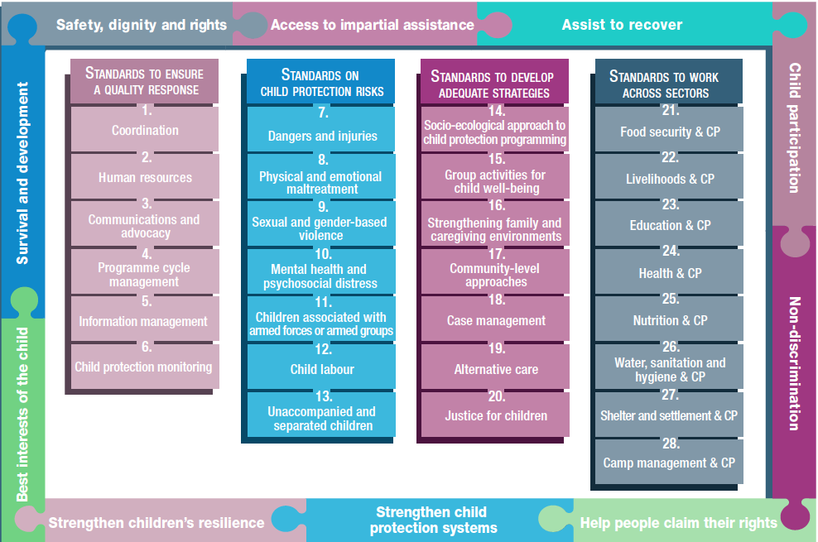
Overview
Notes:
This is an overview of the CPMS structure: there are 28 Standards across 4 pillars and 10 CPHA principles threaded throughout.
You can find this overview on the back of the CPMS handbook or in the online handbook; it’s a practical way of locating quickly a specific topic.
This presentation focuses on Standard 22: Livelihood & Child Protection

Slide 4
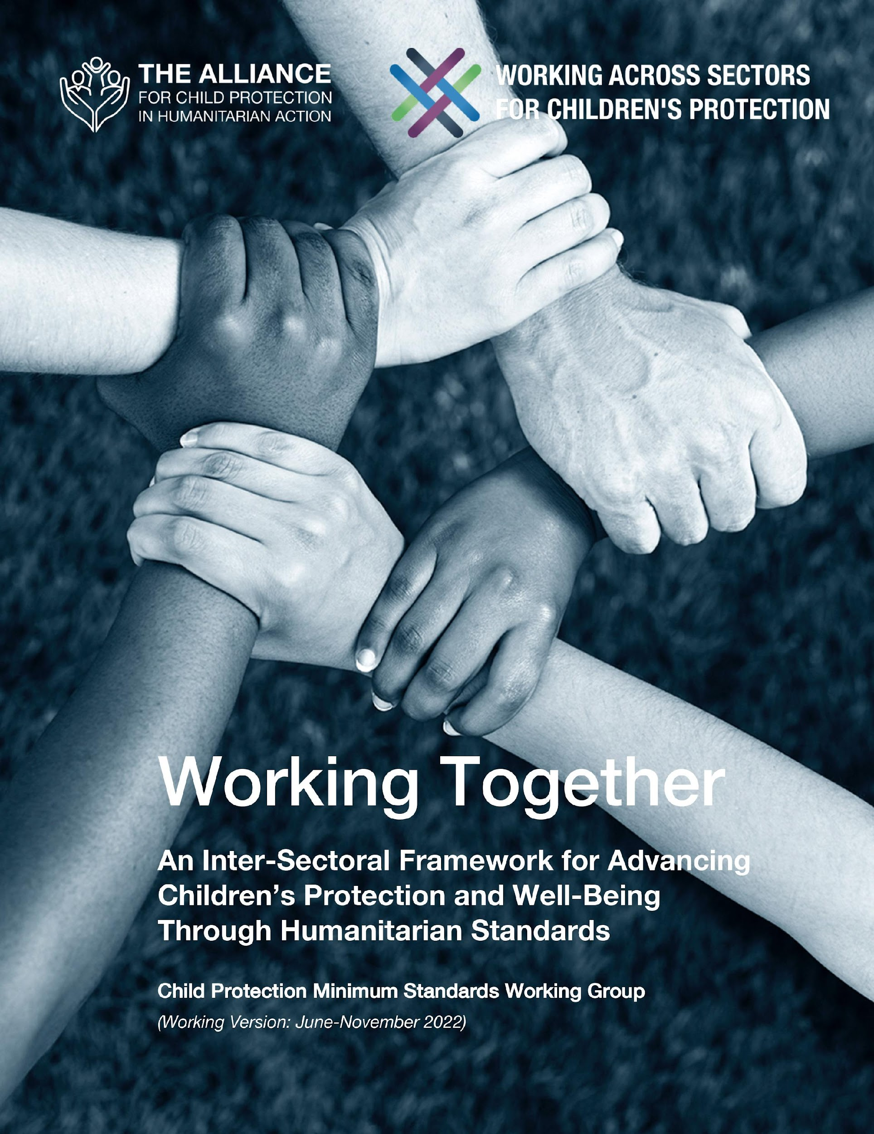
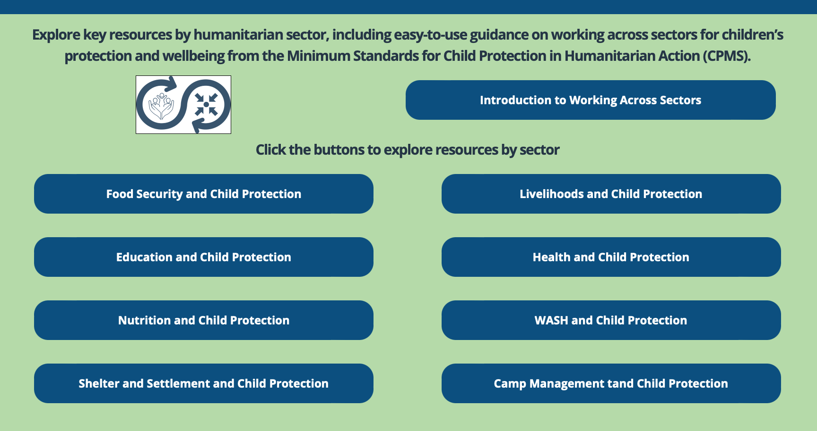
Working Together
Interconnected needs of children
Collective responsibility = Centrality of Protection
Higher-quality impact
Notes:
The CPMS have a complete section devoted to Child Protection personnel working with and learning from other humanitarian actors to improve protection and well-being outcomes for children.
CLICK: Multisectoral approaches reflect the interconnected needs of children and emphasise
CLICK: all humanitarian actors’ collective responsibility to protect children and their families. Children’s protection risks are closely linked with the work of humanitarian actors because they have needs that fall under all sectors.
CLICK: Multisectoral programming - that includes and addresses child protection considerations (such as children’s particular risks, vulnerabilities, developmental stages, etc.) can be an effective way to achieve real, higher quality outcomes for both / all sectors.
CLICK: Working Together is an inter-sectoral framework to promote children’s protection and well-being using humanitarian standards. It was created through a large-scale, consultative process, and is updated every 6 months. Currently, the prioritized sectors are: health, education, Food Security, and Camp Coordination and Camp Management.
CLICK: Check out the microsite for the global Working across Sectors initiative and the sector-specific resource folders.

Slide 5
An introduction to Standard 22
Interconnected needs of children
Collective responsibility = Centrality of Protection
Higher-quality impact
Significant protective impact on children
Integration = no increased risks and no harm caused to children
Contextualised, gendered and/or cultural considerations
In the absence of formal jobs, what types of livelihood may children do?
Notes:
This Standard is part of the fourth Pillar of Standards related to Working across Sectors.
Multisectoral approaches reflect the interconnected needs of children and emphasise all humanitarian actors’ collective responsibility to protect children and their families. Child protection risks are closely linked with the work of other sectors because children have needs that fall under all sectors.
One very effective way towards real & higher quality impact is multisectoral programming that includes and addresses child protection considerations (such as children’s particular risks, vulnerabilities, developmental stages, etc.).
DEF = ‘livelihood’: capabilities, assets, opportunities and activities to be able to make a living (to earn enough income to meet their basic and essential needs).
When a family’s capacity to provide adequate food, shelter, education and care is reduced, children can be at risk of all forms of child protection concerns. Economic recovery and livelihoods interventions can have a significant protective impact on children
Child protection must be integrated into livelihoods programme activities to ensure that they do not increase risks and cause harm to children.
This standard emphasize the traditional stereotypes, obstacles related to gender or cultural norms around appropriate work for genders or groups, that have links with economic dependence on others, exclusion from formal jobs, exploitative, informal work environments & abusive relationships
Icon: focus on targeting economic recovery and livelihoods interventions appropriately at caregivers and older children of working age [🡪 the Adolescent icon]
Discussion Prompt: In the absence of formal jobs, what types of livelihood may children do?
->In the absence of formal jobs, children at risk may:
Find work in the informal economy;
Enter exploitative work environments;
Become dependent on and trapped in abusive relationships; or
Experience sexual exploitation.

Slide 6
Joint Prevention Actions
“Caregivers and working-age children have access to adequate support to strengthen their livelihoods.”
Identification, analysis, monitoring of and response
Gender or cultural norms analysis
Child protection focal points within livelihoods teams
Can you think of practical topics to strengthen livelihood staff’s capacity to protect children?
Notes:
Standard 22 states: “Caregivers and working-age children have access to adequate support to strengthen their livelihoods.”
Existing livelihoods and child protection assessment and monitoring tools, methodologies, prioritisation criteria and indicators can be adapted for joint identification, analysis, monitoring of and response to households at risk of livelihood insecurity and/or child protection concerns
It is important to be aware of traditional stereotypes around appropriate work for genders or groups. Women, adolescent girls and other at-risk groups often face obstacles related to gender or cultural norms. These norms not only increase economic dependence on others but can also increase their vulnerability to violence. (i.e: we should provide beneficiary cards to child heads of households and children who are unaccompanied or separated so they can access assistance in their own names and register all adult women as the main recipients of assistance in contexts where polygamy is practiced to avoid excluding subsequent wives and their children)
To support joint identification and mitigation of child protection risks, consider establishing child protection focal points within livelihoods teams. Focal points can support collaboration, encourage agreement on key decisions and processes, refer child protection concerns and ensure livelihoods interventions are child-friendly, accessible and safe.
Discussion Prompt: Can you think of practical topics to strengthen livelihood staff’s capacity to protect children ?
-> You can:
Train livelihoods staff on child protection concerns, principles and approaches so they can safely, correctly and efficiently refer disclosed or identified sexual and gender-based violence and child protection cases.
Ensure that all livelihoods and child protection staff are trained on and sign safeguarding policies and procedures

Slide 7
Joint Response Actions
Cash and voucher assistance
Response interventions
Participation
Feedback and reporting mechanisms; data protection protocols & referrals
REMINDER
Impact
Do no harm
Gender-, age- and disability-related needs
Gaps, bottlenecks and barriers
Notes:
Multipurpose cash, in certain circumstances, increase families’ and children’s abilities to meet their basic needs. When combined with other services, they may help reduce negative coping mechanisms such as child labour or child marriage. The impact of multipurpose cash on child protection outcomes should be closely monitored.
We should implement response interventions for households at risk of livelihood insecurity and/or child protection concerns throughout all phases of the programme cycle and ensure that they are safe, inclusive, protective and accessible to all children; address children’s different genders, ages, disabilities, developmental stages, vulnerabilities and family settings; do not interfere with school attendance
We should consult with disaggregated groups from the affected population regularly about their preferences and priorities for income generation, cash-for-work opportunities and other household needs; ensure adequate representation of children in decision-making processes, community-based participation structures and site governance systems related to livelihoods, and include all subgroups of the affected population in designing, implementing and monitoring livelihoods interventions.
Confidential, child-friendly, multisectoral, accessible and harmonised Accountability to Affected Population (AAP) feedback and reporting mechanisms, data protection protocols & referrals to economic recovery, cash and voucher assistance and livelihoods support should be set up in collaboration with the communities
REMINDER:
Consider the impact of livelihoods interventions on childcare and school attendance;
Avoid potentially exploitative or unsafe working conditions for older children and caregivers; and identify profitable, accessible and desirable livelihood activities that minimise the risks of child labour, exploitation, poor quality childcare and irregular school attendance
Integrate the gender-, age- and disability-related needs of working-age children into all aspects of programming;
Mitigate any gaps, bottlenecks or barriers to children’s access to existing social protection services and livelihoods support (Safety risks; Unequal access to livelihoods opportunities; and Discrimination based on gender, disability, household composition, etc.);

Slide 8
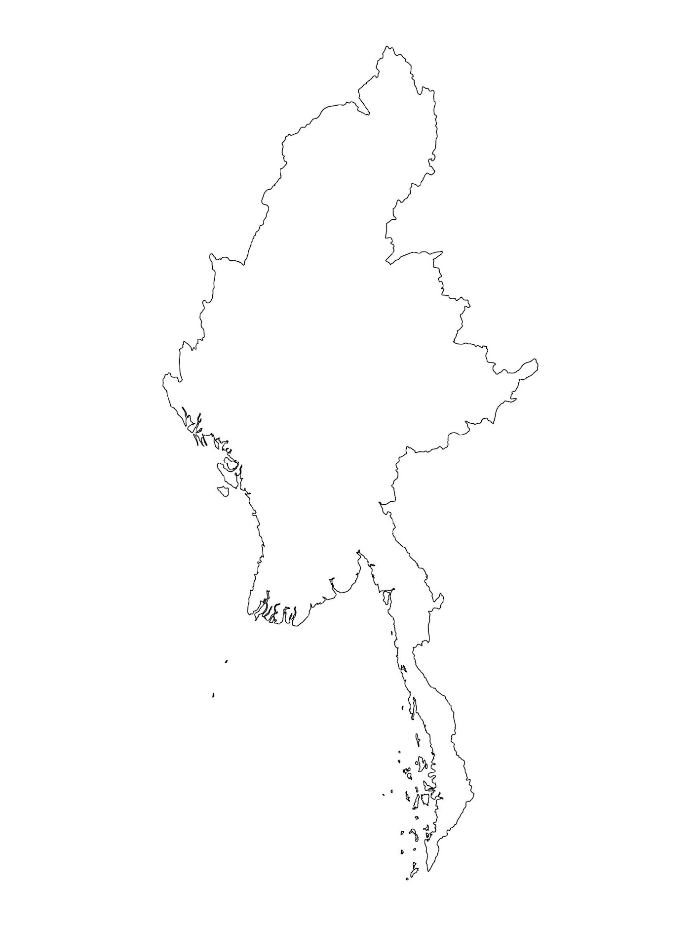
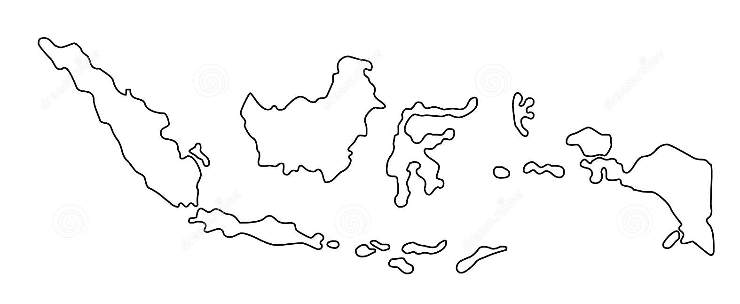
Examples from the Region
[COUNTRY NAME]
Add key presentation sentence about a specific program/project using Standard 22
Add name of organisations
Add key message / numbers
[ COUNTRY NAME]
Add key presentation sentence about a specific program/project using Standard 22
Add name of organisations
Add key message / numbers
[ COUNTRY NAME]
Add key presentation sentence about a specific program/project using Standard 22
Add name of organisations
Add key message / numbers
Notes:
Depending on the time you have for facilitation, consider adding here examples from the Region/ Country/ Response, of programming that meets the standards.
This could be a draft slide that you could update or remove if necessary.
For each example, you could add:
A short, concise, key presentation sentence about the specific program/project using Standard 22
Add the name of organisations and partners involved
Add practical lessons learnt, key actions, message or numbers, that will attract interest of your audience
Another option, if you have a longer facilitation span (and also depending on the audience you have), this slide can be completed in an interactive way during the session.
In that case, you could:
split the groups into 2 or 3 smaller groups,
allow 15 – 20 min for them to prepare a short presentation of an example from the Region/ Country/ Response, of programming that meets the standard
in plenary, have the groups present their examples, and discuss /compare lessons learnt out of them.
If you will be sending this presentation to the participants after the training, you can fill up this slide, to keep records of the presentations.
TIP: you can use https://thenounproject.com/ to get map outlines like those.

Slide 9
Need more than the hard copy?
On the Alliance website
PDF version
Briefing & Implementation Pack
25-page Summary
E-course
YouTube videos
A gallery of illustrated Standards
👉 www.AllianceCPHA.org
On the Humanitarian Standards Partnership website
Online, interactive version
HSP App for mobile phones and tablets
👉 www.HumanitarianStandardsPartnership.org
Notes:
[Facilitators - if you can project from the internet, then we suggest you navigate people there and show them]
HSP:
1. Online handbook
2. The Humanitarian Standards Partnership App
– It is the 2nd most popular app on that site after Sphere
CPMS page:
1. Interactive handbook – our greatest resource
2. A Summary: At just 32 pages, it means that it is topline but can be used to introduce the idea of minimum standards or start child protection discussions with government colleagues or other humanitarians without overwhelming them with the huge handbook.
Alliance website:
The PDF & all materials available can be downloaded if people want to print just portions of the CPMS, on the Alliance site
The “Introduction to CPMS” Briefing Pack contains this PPT and facilitation notes, plus the 2 page Introduction handout.
A gallery of illustrated Standards
Discover our free CPMS e-course with a range of modules
Videos on the Alliance Youtube channel
ASK: What should our next steps as a team/agency/individual be?
(i.e. you might schedule a longer meeting to digest the changes and create a plan; or ask colleagues to present certain new/revised standards and their implications for the programme; or set up a training or ask Senior Management for a meeting to discuss accountability to children, etc)
[Facilitators - Printed copies – there is a small stockpile of the Handbook and Summary that the global Alliance has in Geneva; however, countries and regions are encouraged to print & manage their own copies locally. Usually, this would be done through the inter-agency Coordination structure. On request, the Alliance can share a print-ready PDF.]
Thank you so much for coming together and starting to explore the CPMS. I will follow up on the next steps we discussed. And that’s the key – the CPMS is a gift that just keeps on giving every time you open it!

