Slide 1
The Minimum Standards for Child Protection in Humanitarian Action
CPMS
SLIDE DECK
Notes:
Facilitators:
This briefing is for any potential user of the CPMS. It is geared primarily toward child protection staff, so consider broadening some questions or providing more detail, if colleagues from other sectors join you.
It is assumed that the group is about 20 people and that everyone in the room knows each other (perhaps colleagues from your agency or the CP coordination group). if not, add 5 minutes for quick introductions.
PREPARE: a flipchart with the objectives of the session
By the end of the session, participants will be able to:
Describe the content of Standard 1
Explain & Share its key messages
Demonstrate how & why to use the handbook
NOTE: if you have already done a Session on Pillar(s), Principles or other Standard(s), skip slide 2 & 8
TIP: Slides are animated -> for each click you’ll make, some few words, a title or an image will appear on the slide.
Read the corresponding notes from the facilitators notes, before showing the following content, so participants have time to process what you say, and read each point.

Slide 2
Aim of the Standards
Benchmark for CPHA.
Collaborative, inter-agency tool
Links with Core Humanitarian Standard
Contextualisation for local ownership
Purpose:
quality and accountability
impact for children’s protection and well-being
Notes:
Donors, local governments, colleagues in other sectors and our beneficiaries themselves want to know what we are doing and why. The CPMS are our benchmark. They are the key way to operationalise or make real children's rights in the practice of humanitarian response.
They are a collaborative, inter-agency tool, that links with other initiatives, such as the Core Humanitarian Standard, INSPIRE and the Humanitarian Inclusion Standards
Wherever relevant, the CPMS aligne with INSPIRE’s 7 strategies to end violence against children – initiative’s icons are actually scattered through the text. In addition, the Core Humanitarian Standard on Quality and Accountability is highlighted in the Introduction and resonates throughout the handbook.
Contextualisation is encouraged and can create ownership of the standards at every level. It builds a deeper understanding of child protection in the specific context for a wide range of actors. National coordination groups are therefore encouraged to adapt the CPMS. Please raise it with colleagues locally and then seek the guidance of the global CPMS team. For more information, watch the short contextualization video on the Alliance’s youtube channel.
BOX: The CPMS aim at improving the quality and accountability of our programing and increasing impact for children’s protection and well-being in humanitarian action (internal displacement and refugee contexts), by establishing common principles, evidence, prevention and goals to achieve. They provide a synthesis of good practice and learning to date.

Slide 3
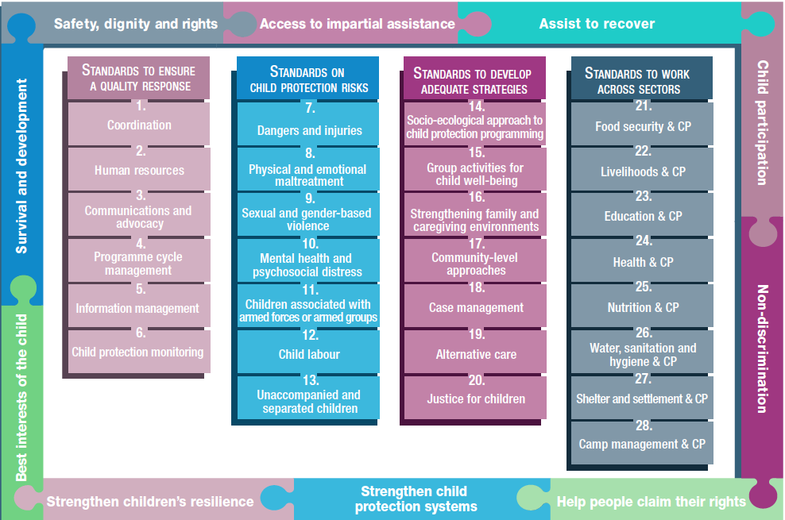
Overview
Notes:
This is an overview of the CPMS structure: there are 28 Standards across 4 pillars and 10 CPHA principles threaded throughout.
You can find this overview on the back of the CPMS handbook or in the online handbook; it’s a practical way of locating quickly a specific topic.
This presentation focuses on Standard 1: Coordination

Slide 4
General intro to Standard 1
Part of Pillar 1 related to quality response
To be used w/ Standards (7–28) & the CPMS principles
Commitment 6 of the CHS
Shared responsibility
Effectiveness and efficiency of humanitarian responses
Do no harm
Who is concerned by coordination?
Notes:
This Standard is part of the first Pillar of Standards related to quality response, which are common across all areas of child protection programming, applicable in all situations and contexts, during preparedness and response phases. They are ALL fundamental to reach the quality we as practitioners are aiming for.
These Quality standards should be used in conjunction with all the rest of the Standards (7–28) & the CPMS principles.
This Standard is complementary to the Core Humanitarian Standard on Quality and Accountability (CHS), and should be used with it. More specifically, it links with Commitment Six: Communities and people affected by crisis receive coordinated, complementary assistance.
Quality Criterion: Humanitarian response is coordinated and complementary
Calls for everyone involved in child protection to agree on a shared set of objectives and division of labour, and to coordinate actions to protect all affected children in a timely, efficient manner, to guarantee effectiveness and efficiency.
Discussion Prompt: who is concerned by coordination?
Government (its leadership ensures the sustainability of coordination)
National and local actors
UN agencies (Specific United Nations agencies may act as co-chairs, i.e. UNICEF for CP, Education and WASH; UNHCR for child protection in refugee settings)
INGOs,
other stakeholders involved in CP (any organisation / actor / stakeholder / mechanism, either formal and informal; private, non-profit and public can be member of coordination groups)
Neighboring states, in the case of cross-border coordination mechanisms (particularly relevant for migrants). In refugee situations, cross-border coordination is carried out at the regional level with other countries hosting refugees from the same country/ies. Usually, coordination doesn’t take place with country from which the refugees fled because they faced violence, persecution or human rights violations as it may put refugees at further risks
Affected persons and communities
Government leadership is paramount, but there are situations in which government is not able or willing to coordinate a response. In those cases, and in support of the government, UNICEF and UNHCR, in accordance with their specific mandates, will take on the leadership role and invite experienced organizations to co-coordinate the child protection.
National and local actors also have a critical role to play into coordination, to link with, build on, or support existing coordination and response mechanisms, and strengthen national and local ownership and capacities.

Slide 5
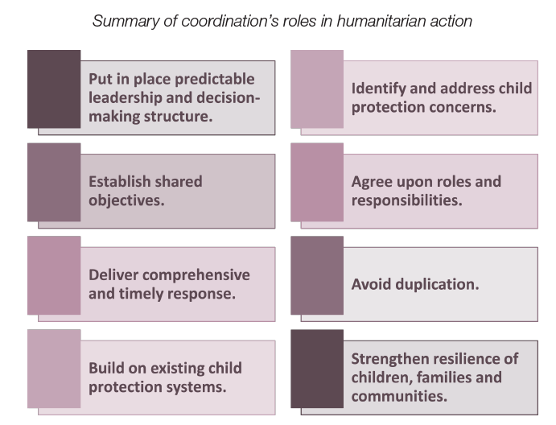
“Authorities, humanitarian agencies, civil society organisations and affected populations coordinate actions to protect all affected children in a timely, efficient manner.”
Notes:
Standard 1 states : “Authorities, humanitarian agencies, civil society organisations and affected populations coordinate actions to protect all affected children in a timely, efficient manner.”
Effective coordination serves many roles in humanitarian action. These are summarised in the diagram on the right.

Slide 6
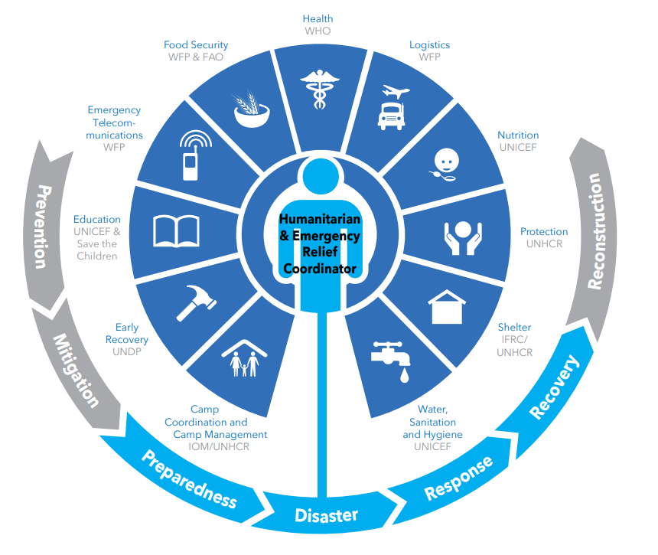
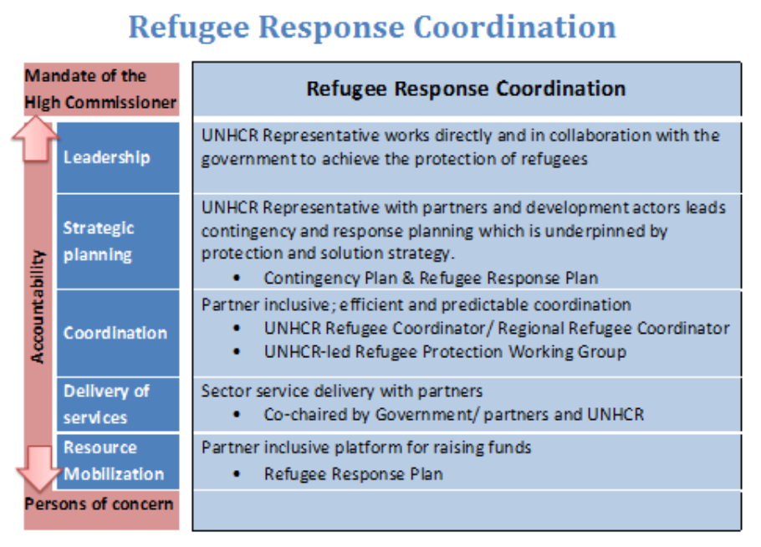
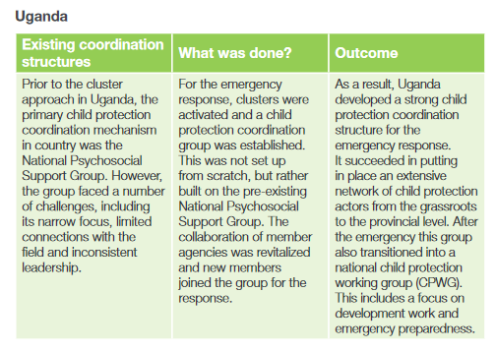
Coordination structures
Notes:
It exists different coordination structures in different contexts (refugees and IDP or mixed situations)
[→ the displacement icon]
The coordination structure is defined based on the following scenarios:
Situations under leadership of a Humanitarian Coordinator and early warning contexts (internally displaced persons settings: Child Protection is coordinated by the Child Protection Area of Responsibility, within the Global Protection Cluster. As the designated global lead agency for child protection coordination, UNICEF is responsible at country level for supporting existing humanitarian coordination, setting-up and staffing a new coordination group or working with another organisation to do so.
Situations of asylum seekers, refugees, stateless persons and refugee returnees: UNHCR is responsible for supporting governments to seek solutions and provide international protection and assistance for asylum-seekers and refugees and coordinate the refugee operations, including child protection. UNHCR establishes the Refugee Protection Working Group and leads with the host government, where feasible. In consultation with partners, UNHCR establish child protection coordination mechanism based on coordination needs, as it varies from sub-working group on child protection to standing agenda item on the Refugee Protection Working Group.
Mixed situations (where affected population includes both refugee and IDPs): Where refugees and internally displaced persons reside in the same geographical location, the High Commissioner for Refugees and the Emergency Relief Coordinator jointly decide whether to use refugee sectors or the Cluster Approach
Humanitarian response to infectious disease outbreaks In a humanitarian response to an infectious disease outbreak, it may be that neither the cluster approach nor the refugee coordination model is used. It may therefore be necessary to engage with multiple other coordination groups or systems to seek ways to incorporate child protection response actions.
In all scenarios, linking with and strengthening existing national systems and coordination mechanisms rather than creating new ones is fundamental.

Slide 7
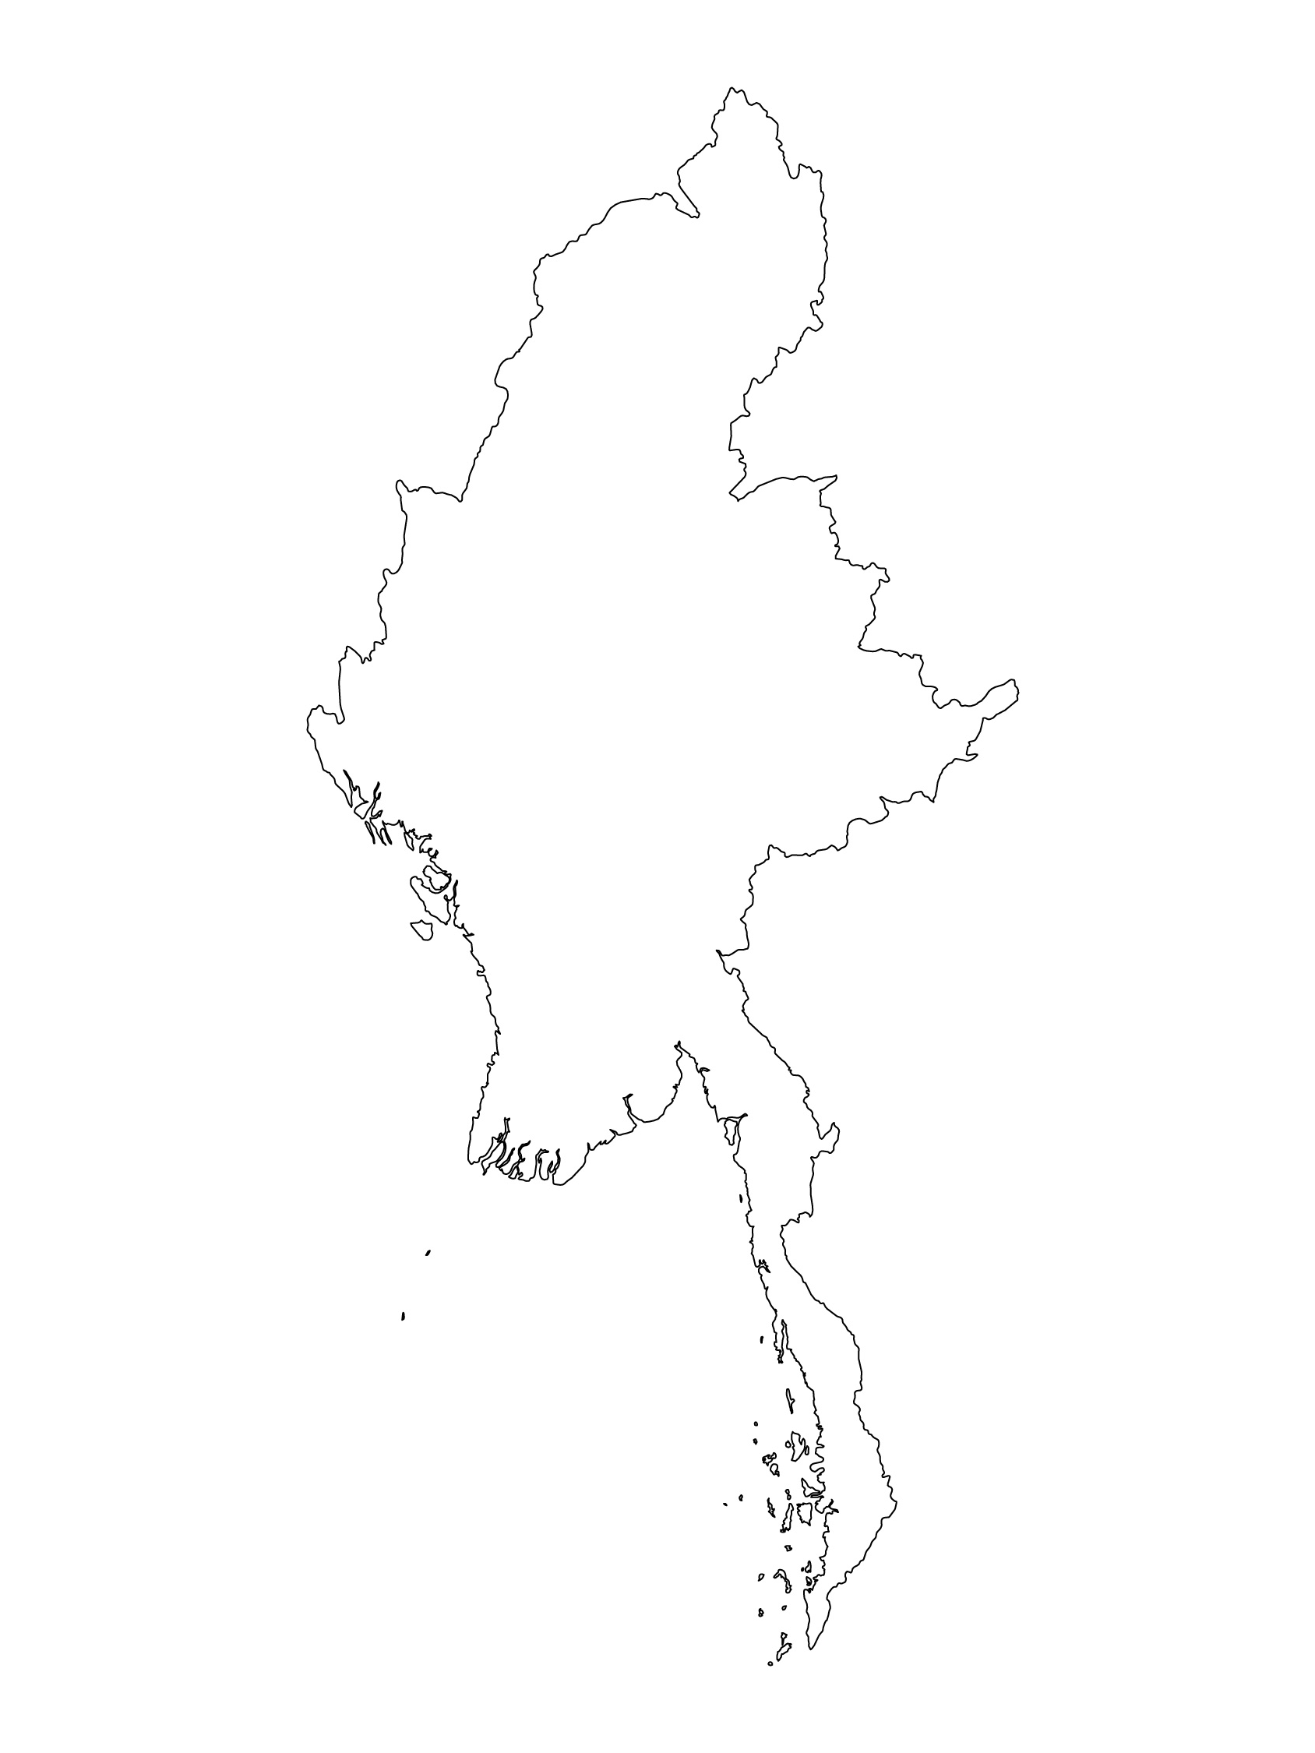
Examples from the Region
[COUNTRY NAME]
Add key presentation sentence about a specific guidance/ tools/ activity undertaken by the cooordination group
Add key message / numbers
[ COUNTRY NAME]
Add key presentation sentence about a specific guidance/ tools/ activity undertaken by the cooordination group
Add key message / numbers
[ COUNTRY NAME]
Add key presentation sentence about a specific guidance/ tools/ activity undertaken by the cooordination group
Add key message / numbers
Notes:
Depending on the time you have for facilitation, consider adding here examples from the Region/ Country/ Response, of programming that meets the standards.
This could be a draft slide that you could update or remove if necessary.
For each example, you could add:
A short, concise, key presentation sentence about a specific guidance/ tools/ activity undertaken by the cooordination group
Add practical lessons learnt, key actions, message or numbers, that will attract interest of your audience (numbers of children reached; of partners involved; of beneficiaries trained etc?)
Another option, if you have a larger facilitation span (and also depending on the audience you have), this slide can be completed in an interactive way during the session.
In that case, you could:
split the groups into 2 or 3 smaller groups,
allow 15 – 20 min for them to prepare a short presentation of an example from the Region/ Country/ Response, of programming that meets the standard
in plenary, have the groups present their examples, and discuss /compare lessons learnt out of them.
If you will be sending this presentation to the participants after the training, you can fill up this slide, to keep records of the presentations.
TIP: you can use https://thenounproject.com/ to get map outlines like those.

Slide 8
Need more than the hard copy?
On the Alliance website
PDF version
Briefing & Implementation Pack
25-page Summary
E-course
YouTube videos
A gallery of illustrated Standards
👉 www.AllianceCPHA.org
On the Humanitarian Standards Partnership website
Online, interactive version
HSP App for mobile phones and tablets
👉 www.HumanitarianStandardsPartnership.org
Notes:
[Facilitators - if you can project from the internet, then we suggest you navigate people there and show them]
HSP:
1. Online handbook
2. The Humanitarian Standards Partnership App
– It is the 2nd most popular app on that site after Sphere
CPMS page:
1. Interactive handbook – our greatest resource
2. A Summary: At just 32 pages, it means that it is very topline but can be used to introduce the idea of minimum standards or start child protection discussions with government colleagues or other humanitarians without overwhelming them with the huge handbook.
Alliance website:
The PDF & all materials available can be downloaded if people want to print just portions of the CPMS, on the Alliance site
The “Introduction to CPMS” Briefing Pack contains this PPT and facilitation notes, plus the 2 page Introduction handout.
A gallery of illustrated Standards
Discover our free CPMS e-course with a range of modules
Videos on the Alliance Youtube channel
ASK: What should our next steps as a team/agency/individual be?
(i.e. you might schedule a longer meeting to digest the changes and create a plan; or ask colleagues to present certain new/revised standards and their implications for the programme; or set up a training or ask Senior Management for a meeting to discuss accountability to children, etc)
[Facilitators - Printed copies – there is a small stockpile of the Handbook and Summary that the global Alliance has in Geneva; however, countries and regions are encouraged to print & manage their own copies locally. Usually, this would be done through the inter-agency Coordination structure. On request, the Alliance can share a print-ready PDF.]
Thank you so much for coming together and starting to explore the CPMS. I will follow up on the next steps we discussed. And that’s the key – the CPMS is a gift that just keeps on giving every time you open it!

