Slide 1
The Minimum Standards for Child Protection in Humanitarian Action
CPMS
SLIDE DECK
Notes:
Facilitators:
This briefing is for any potential user of the CPMS. It is geared primarily toward child protection staff, so consider broadening some questions or providing more detail, if colleagues from other sectors join you.
It is assumed that the group is about 20 people and that everyone in the room knows each other (perhaps colleagues from your agency or the CP coordination group). if not, add 5 minutes for quick introductions.
PREPARE: a flipchart with the objectives of the session
By the end of the session, participants will be able to:
Describe the content of Standard 19
Explain & Share its key messages
Demonstrate how & why to use the handbook
NOTE: if you have already done a Session on Pillar(s), Principles or other Standard(s), skip slide 2 & 7
TIP: Slides are animated -> for each click you’ll make, some few words, a title or an image will appear on the slide.
Read the corresponding notes from the facilitators notes, before showing the following content, so participants have time to process what you say, and read each point.

Slide 2
Aim of the Standards
Benchmark for CPHA.
Collaborative, inter-agency tool
Links with Core Humanitarian Standard
Contextualisation for local ownership
Purpose:
quality and accountability
impact for children’s protection and well-being
Notes:
Donors, local governments, colleagues in other sectors and our beneficiaries themselves want to know what we are doing and why. The CPMS is our benchmark. They are the key way to operationalise or make real children's rights in the practice of humanitarian response.
They are a collaborative, inter-agency tool, that links with other initiatives, such as the Core Humanitarian Standard and the Humanitarian Inclusion Standards
Wherever relevant, the CPMS align with INSPIRE’s 7 strategies to end violence against children – initiative’s icons are actually scattered through the text. In addition, the Core Humanitarian Standard on Quality and Accountability is highlighted in the Introduction and resonates throughout the handbook.
Contextualisation is encouraged and can create ownership of the standards at every level. It builds a deeper understanding of child protection in the specific context for a wide range of actors. National coordination groups are therefore encouraged to adapt the CPMS. Please raise it with colleagues locally and then seek the guidance of the global CPMS team. For more information, watch the short contextualization video on the Alliance’s youtube channel.
BOX: The CPMS aim at improving the quality and accountability of our programing and increasing impact for children’s protection and well-being in humanitarian action (internal displacement and refugee contexts), by establishing common principles, evidence, prevention and goals to achieve. They provide a synthesis of good practice and learning to date.

Slide 3
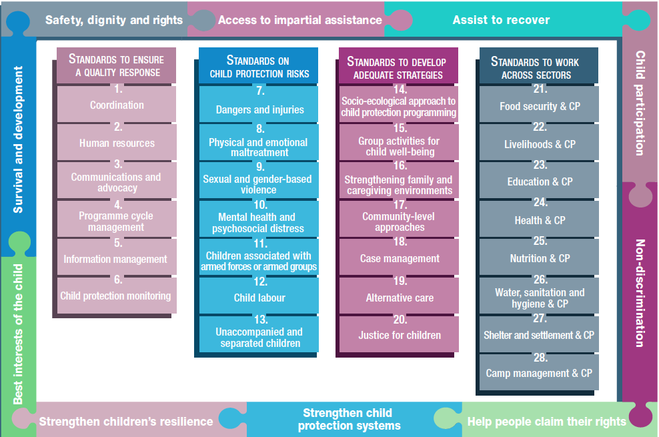
Overview
Notes:
This is an overview of the CPMS structure: there are 28 Standards across 4 pillars and 10 CPHA principles threaded throughout.
You can find this overview on the back of the CPMS handbook or in the online handbook; it’s a practical way of locating quickly a specific topic.
This presentation focuses on Standard 19: Alternative care

Slide 4
An introduction to Standard 19
Key strategies, approaches and interventions
Prevention and response to child protection risks
Protective and suitable care arrangements
Family-based care & family unity
Cultural norms, practices, laws and policies
What are the local cultural norms and practices around children’s care?
Notes:
This Standard is part of the third Pillar of Standards related to developing adequate strategies, approaches and interventions for preventing and responding to the child protection risks outlined in Pillar 2. It is structured around the socio-ecological model and also links with the INSPIRE package, where appropriate, and builds on their evidence-based strategies for preventing violence against children. Hence the ICON in the corner. The INSPIRE package has a similar goal: evidence-based strategies for preventing violence against children. More info about INSPIRE strategies on: http://inspire-strategies.org/
The aim of this Standard is to seek protective and suitable alternative care according to children’s rights, specific needs, wishes and best interests
Priority should always be given to family-based care, family unit and stable care arrangements – because the first and most protective factor in a child’s life is a safe and nurturing family.
Local cultural norms, practices, laws and policies have to be taken into account. Local cultural norms and practices may also help you to identify children that may be more at risk of abandonment or maltreatment. Children with disabilities for example are over 10x more likely to be placed in residential care than those without a disability. (consider ethnic minorities, children born out of wedlock, LGBTQI children etc) We need to design our programmes to prevent abandonment and risks to children.
Discussion Prompt: What are the local cultural norms and practices around children’s care, in your context? Do you know of any groups of children that may be more likely to be placed in alternative care? Why do you think this happens and what do you think could help prevent it?
This Standard has very strong links to Unaccompanied & Separated Children, but also Case Management and the Standard on Strengthening Family & Caregiving Environments.
Icons: Link with Inspire strategies on Parent and caregiver support + Response and support services

Slide 5
“All children without protective and suitable care receive alternative care according to their rights, specific needs, wishes and best interests, prioritising family-based care and stable care arrangements.”
Family-based care -> First option
Residential care -> Last resort
Decision factors
Follow-up visits
Caregivers support
(re)integration or permanent alternative care option
What are different types of alternative care?
Notes:
Standard 19 states: “Family and caregiving environments are strengthened to promote children’s healthy development and to protect them from maltreatment and other negative effects of adversity.”
Discussion Prompt: What are different types of alternative care?
Discuss local and contextualized forms of alternative care with participants. If needed, you can complement their answer with the following:
-> In each context, several alternative care options may be available.
Family-based alternative care (care within a family that is not necessarily the child’s own family) -> the preferred option for children who need alternative care.
Kinship care (care within a family related to or known by the child)
Foster care (placement of the child arranged through the government or a social service agency, in an institution, group home or foster parent) -> should never be the only alternative care option and not replace support to children’s own families
Residential care alternatives (temporary shelters, interim care centres, small group homes and institutional care) -> alternative interim care option for the shortest possible time & as a last resort when all family-based interim care options have been explored, are not possible or are not available. Every effort should be made to minimise an ‘institutional culture’
Supported independent living (especially relevant for adolescents)
For children who are refugees, internally displaced or migrants, this may be done by connecting the child to people from their community of origin who are also in the new host country or location. [🡪 the refugee icon]
Alternative care should only be considered when family strengthening and support to the family have failed. Family strengthening and support to families must be considered first! Alternative care may be the best and safest option for a child who is at risk within his or her family. Alternative care is always be seen as temporary so while considering different options. We should also be thinking about longer term options for children, like being placed back in their family or domestic adoption.
Child protection actors should choose options based on:
Each child’s best interests, including safety considerations;
The individual child’s choices and wishes, age, level of maturity, relationships, schooling, language, religion and culture;
The community’s caring traditions;
The legal framework; and
The principles of necessity and suitability. (Is alternative care absolutely necessary? If so, which option is the most suitable?)
Caseworkers working on alternative care should be trained to make decisions on alternative care placements, including the strengths and weaknesses of each type of care option. No form of alternative care should encourage family separation
Once the best care option is found and child’s best interests considered, in compliance with national legislation, children in care should receive follow-up visits to monitor their protection and well-being.
The caregivers, and/or the family should be supported adequately to care for the children. Caseworkers should assess whether (re)integration into their family or community is in the child’s best interests. If family reunification is impossible or not in a child’s best interest, consider alternative long-term care options.
Note that intercountry adoption should not be considered in the first phase of an emergency, and no adoption should be considered until it is proven a child is eligible for adoption (ie doesn’t have either living biological parents or parents that are willing or able to care for him/her even with support).

Slide 6
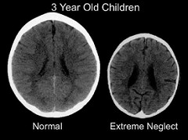
Why residential care is harmful
for children
Child’s physical, mental and emotional development
Bucharest Early Intervention Project (BEIP)
How do we ensure that residential care remains temporary?
Notes:
Decades of research have shown that residential care, especially those larger scale institutions or residential care that follows an institutional nature is extremely harmful to a child’s physical, mental and emotional development – That’s why we are recommending that family based care be considered first.
The Bucharest Early Intervention Project (BEIP) began in 2000 as randomized controlled trial comparing children in institutional care to foster care. All of the children were abandoned around the time of birth and placed in one of six institutions for young children in Bucharest, Romania (Zeanah, et al., 2003) It is a longitudinal study with children still being followed up periodically into adulthood. It followed 136 children with half of the children randomly assigned to high-quality foster care and the other half remained in institutional care. Children were followed up through the age of eight. They compared children in institutional care, those placed in foster care, and those who had never been institutionalised.
Key Results:
Institutional care leads to profound deficits and delays in cognitive and social-emotional development and greater risk of psychiatric disorders and impairment in brain activity.
When a child from residential care is integrated into a family environment (foster care) before two years of age, there is more noticeable cognitive and emotional development than children who stay in residential care.
For every three months that a child is in an institution, they lose one month of development.
In some areas, eight years on, children in foster care looked very similar to children who had never been institutionalised.
For more information on the study and the published articles: http://www.bucharestearlyinterventionproject.org/BEIP-Publications.html
Photo: While this is an extreme example, this is a brain scan of a three year old child in institutional care in Romania compared to an average 3 year old Romanian child that grew up in his/her family. The areas of the brain that are not used, do not develop. While we notice the size of the brain, neuroscientists are also focused on how much more black matter there is in the neglected child.
If you have time enough: Discussion question: How do we ensure that residential care remains temporary? What can we do in our programming and planning to ensure this happens?

Slide 7
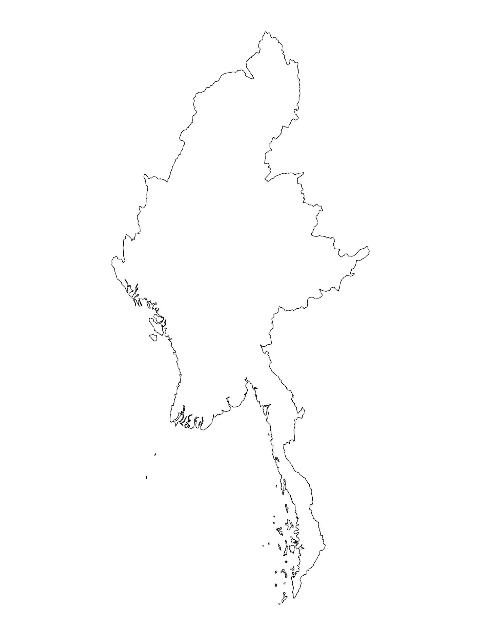
Examples from the Region
[COUNTRY NAME]
Add key presentation sentence about a specific program/project using Standard 19
Add name of organisations
Add key message / numbers
[ COUNTRY NAME]
Add key presentation sentence about a specific program/project using Standard 19
Add name of organisations
Add key message / numbers
[ COUNTRY NAME]
Add key presentation sentence about a specific program/project using Standard 19
Add name of organisations
Add key message / numbers
Notes:
Depending on the time you have for facilitation, consider adding here examples from the Region/ Country/ Response, of programming that meets the standards.
This could be a draft slide that you could update or remove if necessary.
For each example, you could add:
A short, concise, key presentation sentence about the specific program/project using Standard 19
Add the name of organisations and partners involved
Add practical lessons learnt, key actions, message or numbers, that will attract interest of your audience
Another option, if you have a longer facilitation span (and also depending on the audience you have), this slide can be completed in an interactive way during the session.
In that case, you could:
split the groups into 2 or 3 smaller groups,
allow 15 – 20 min for them to prepare a short presentation of an example from the Region/ Country/ Response, of programming that meets the standard
in plenary, have the groups present their examples, and discuss /compare lessons learnt out of them.
If you will be sending this presentation to the participants after the training, you can fill up this slide, to keep records of the presentations.
TIP: you can use https://thenounproject.com/ to get map outlines like those.

Slide 8
Need more than the hard copy?
On the Alliance website
PDF version
Briefing & Implementation Pack
25-page Summary
E-course
YouTube videos
A gallery of illustrated Standards
👉 www.AllianceCPHA.org
On the Humanitarian Standards Partnership website
Online, interactive version
HSP App for mobile phones and tablets
👉 www.HumanitarianStandardsPartnership.org
Notes:
[Facilitators - if you can project from the internet, then we suggest you navigate people there and show them]
HSP:
1. Online handbook
2. The Humanitarian Standards Partnership App
– It is the 2nd most popular app on that site after Sphere
CPMS page:
1. Interactive handbook – our greatest resource
2. A Summary: At just 32 pages, it means that it is very topline but can be used to introduce the idea of minimum standards or start child protection discussions with government colleagues or other humanitarians without overwhelming them with the huge handbook.
Alliance website:
The PDF & all materials available can be downloaded if people want to print just portions of the CPMS, on the Alliance site
The “Introduction to CPMS” Briefing Pack contains this PPT and facilitation notes, plus the 2 page Introduction handout.
A gallery of illustrated Standards
Discover our free CPMS e-course with a range of modules.
Videos on the Alliance Youtube channel
ASK: What should our next steps as a team/agency/individual be?
(i.e. you might schedule a longer meeting to digest the changes and create a plan; or ask colleagues to present certain new/revised standards and their implications for the programme; or set up a training or ask Senior Management for a meeting to discuss accountability to children, etc)
[Facilitators - Printed copies – there is a small stockpile of the Handbook and Summary that the global Alliance has in Geneva; however, countries and regions are encouraged to print & manage their own copies locally. Usually, this would be done through the inter-agency Coordination structure. On request, the Alliance can share a print-ready PDF.]
Thank you so much for coming together and starting to explore the CPMS. I will follow up on the next steps we discussed. And that’s the key – the CPMS is a gift that just keeps on giving every time you open it!

