Slide 1
The Minimum Standards for Child Protection in Humanitarian Action
CPMS
SLIDE DECK
Notes:
Facilitators:
This briefing is for any potential user of the CPMS. It is geared primarily toward child protection staff, so consider broadening some questions or providing more detail, if colleagues from other sectors join you.
It is assumed that the group is about 20 people and that everyone in the room knows each other (perhaps colleagues from your agency or the CP coordination group). if not, add 5 minutes for quick introductions.
PREPARE: a flipchart with the objectives of the session
By the end of the session, participants will be able to:
Describe the content of Standard 13
Explain & Share its key messages
Demonstrate how & why to use the handbook
NOTE: if you have already done a Session on Pillar(s), Principles or other Standard(s), skip slide 2 & 8
TIP: Slides are animated -> for each click you’ll make, some few words, a title or an image will appear on the slide.
Read the corresponding notes from the facilitators notes, before showing the following content, so participants have time to process what you say, and read each point.

Slide 2
Aim of the Standards
Benchmark for CPHA.
Collaborative, inter-agency tool
Links with Core Humanitarian Standard
Contextualisation for local ownership
Purpose:
quality and accountability
impact for children’s protection and well-being
Notes:
Donors, local governments, colleagues in other sectors and our beneficiaries themselves want to know what we are doing and why. The CPMS are our benchmark. CPMS are the key way to operationalise or make real children's rights in the practice of humanitarian response.
They are a collaborative, inter-agency tool, that links with other initiatives, such as the Core Humanitarian Standard, INSPIRE and the Humanitarian Inclusion Standards
Wherever relevant, the CPMS align with INSPIRE’s 7 strategies to end violence against children – initiative’s icons are actually scattered through the text. In addition, the Core Humanitarian Standard on Quality and Accountability is highlighted in the Introduction and resonates throughout the handbook.
Contextualisation is encouraged and can create ownership of the standards at every level. It builds a deeper understanding of child protection in the specific context for a wide range of actors. For more information, watch the short contextualization video on the Alliance’s youtube channel. National coordination groups areencouraged to adapt the CPMS. Please raise it with colleagues locally and then seek the guidance of the global CPMS team.
BOX: The CPMS aim at improving the quality and accountability of our programing and increasing impact for children’s protection and well-being in humanitarian action (internal displacement and refugee contexts), by establishing common principles, evidence, prevention and goals to achieve. They provide a synthesis of good practice and learning to date.

Slide 3
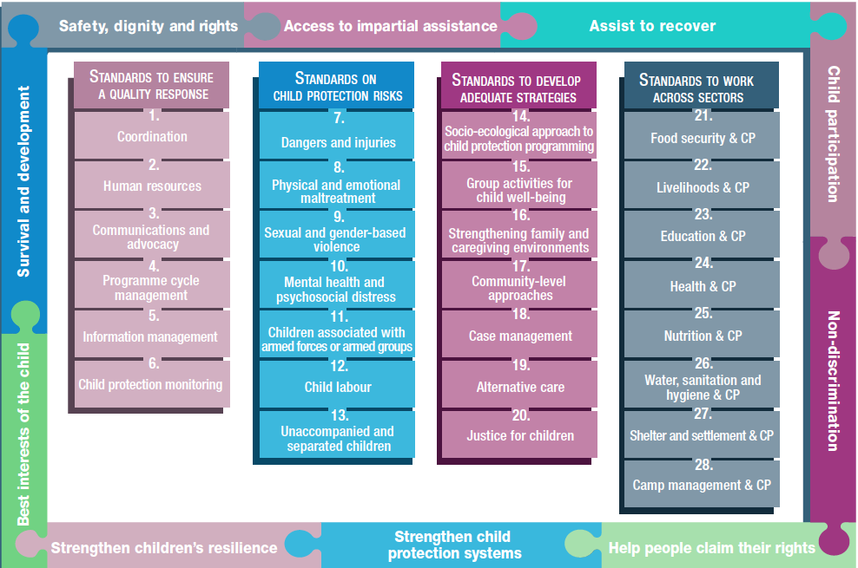
Overview
Notes:
This is an overview of the CPMS structure: there are 28 Standards across 4 pillars and 10 CPHA principles threaded throughout.
You can find this overview on the back of the CPMS handbook or in the online handbook; it’s a practical way of locating quickly a specific topic.
This presentation focuses on Standard 13: Unaccompanied & Separated children

Slide 4
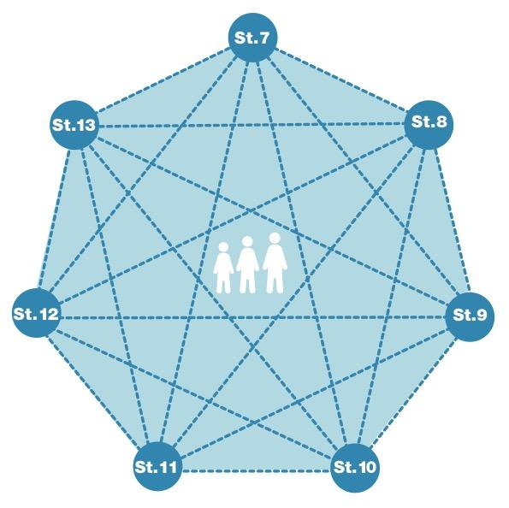
General intro to Standard 13
Part of 2nd Pillar, related to child protection risks
RISK = Nature & Extent of hazard + Vulnerability - Resilience
Rights, BIC and centrality of children
Family unity is priority
Case management and immediate FTR
Notes:
This Standard is part of the second Pillar related to child protection risks that children may face in humanitarian settings. All the seven different risk standards are linked, as they address overlapping vulnerabilities and risks. The risks cannot be addressed in isolation.
Child protection risks are potential violations and threats to children's rights that will cause harm to children. To understand a child's risk, we need to understand the nature (type of hazard, situation, threat…) & extent of the risk and the individual child’s vulnerability to that risk, but also the family/child coping or survival strategies (meaning their resilience and ability to withstand the risk). Vulnerability is understood as the extent to which a child has characteristics that reduce his ability to withstand adverse impact. We have to record that vulnerability is specific to each person and each situation
DEF: When an armed conflict or other disaster occurs, many children become separated from their parents or other care-givers. They are referred to as ‘separated’ or ‘unaccompanied children’ rather than orphans. Family separation can result from a variety of causes, both accidental and deliberate. In addition to causing emotional distress, separation may create significant barriers to accessing humanitarian assistance.
Care and protection has to be provided in timely, safe, appropriate and accessible ways, in accordance with children’s rights and best interests.
This standard highlights the commitment to keeping the child at the centre of humanitarian efforts
The humanitarian response should work to reduce separation, to reunite children with family members and to provide quality, family-based interim care where necessary. Preserving family unity is key. We have to always assume that children have family with whom they can be reunited.
Ensure case management and immediate family tracing and reunification (FTR) [→ see icon]

Slide 5
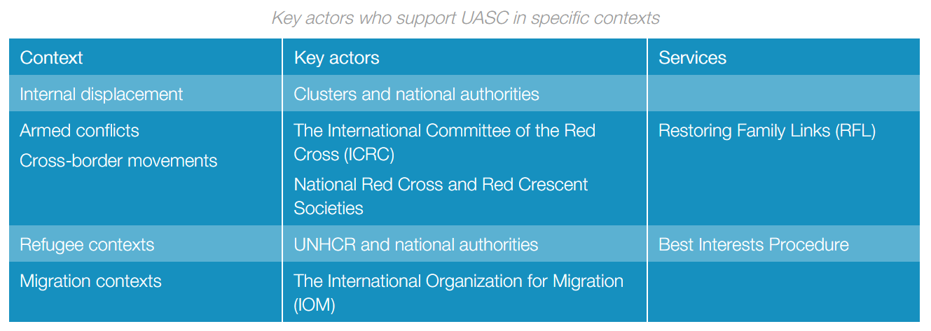
“Family separation is prevented, and unaccompanied and separated children receive care and protection in timely, safe, appropriate and accessible ways in accordance with their rights and best interests.”
Who is involved in UASC support in each specific context?
Notes:
Standard 13 states: “Family separation is prevented, and unaccompanied and separated children receive care and protection in timely, safe, appropriate and accessible ways in accordance with their rights and best interests.”
It calls for coordinated efforts to prevent and respond to child separation and provide assistance, protection and services to UASC (including in refugees context and cross border situation) [→ the displacement icon] Contextualised measures for preventing separation are especially important in non-camp or urban contexts where communities may be dispersed.
Practical actions include:
- Attaching identification tags or wrist bracelets to babies, young children and children with disabilities;
- Teaching children key information about their family identity, home and emergency meeting points; and
Advocating with authorities and other actors to address policies, procedures or practices that are contributing to separation.
Carrying documentation that verifies children’s legal identity, if safe
Informing families of the importance of birth registration
Training relevant actors on methods for preventing separation, for identifying UASC & about response actions (including focal points and border and immigration officials)
Discussion Prompt: Who is involved in UASC support in each specific context?
Specific contexts call for specific actors: the standard identifies the key actors involved in national or international family tracing activities, depending on the context (internal displacement, refugees, migration, cross-border situations, armed conflicts).
-> discuss contextualized settings in the country you are in, and click to show the table
Note that in the case of refugee contexts, there are specific procedures & services to put in place, like the Best Interests Procedure

Slide 6
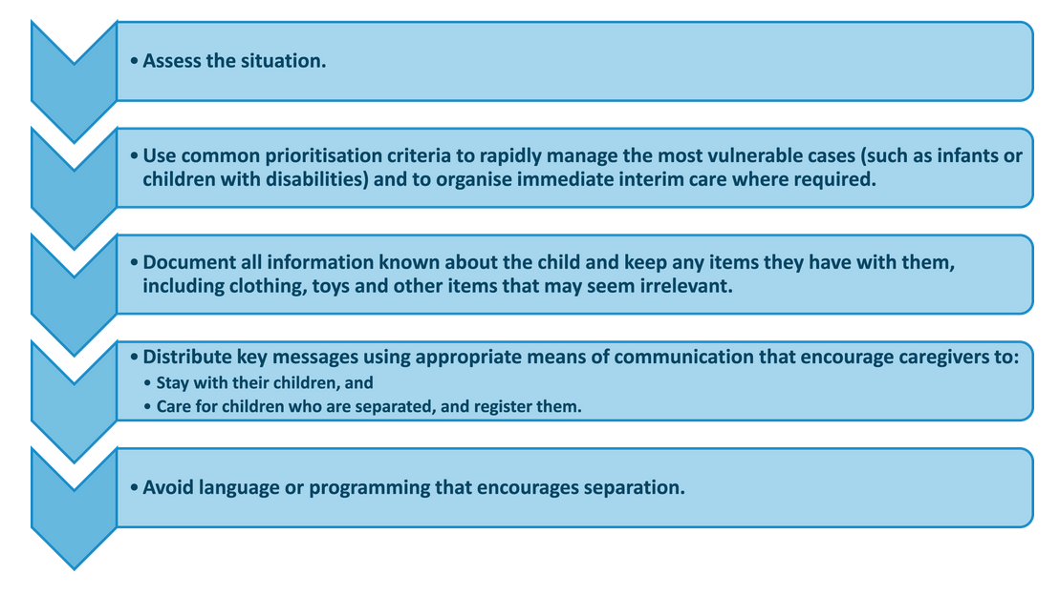
Key steps …
Process…
Identification
Registration, assessment and documentation
Tracing
Verification
Family reunification and reintegration
Follow-up
…To prevent separation, reunite families and start family tracing
Within the first 24–48 hours
Notes:
Within the first 24–48 hours after a sudden-onset humanitarian crisis, follow the key steps outlined in the diagram to prevent separation, help reunite families and start family tracing.
Identification:
The first step is to develop an inter-agency identification and referral mechanism. The community should be informed of the purpose of identifying UASC to avoid creating (a) ‘pull factors’ for separation or (b) fears that children will be taken away. Child protection ‘help desks’ or screening points should be established in key locations (registration points, medical facilities, market areas, etc.) to support key multisectoral actors (immigration officials, detention workers, etc.).
Registration, assessment and documentation:
Appropriate standards and procedures for information and case management should be followed when collecting and storing data on children, including information about interim care placements and family tracing and reunification. Trained staff should carry out registration for case management, documentation and assessments in ways that avoid unnecessary distress or further separation.
Tracing:
‘Tracing’ is the process of searching for either a missing child or a child’s absent parents, primary legal or customary caregivers, or other close family members. Tracing can take months or years, so it is essential to find immediate interim care options, preferably family-based, for children without adequate care.
Tracing activities must follow appropriate guidance, which includes conducting an analysis of the risks different methods may pose to the child. It is important to remember that successful tracing may not always result in family reunification.
Verification:
‘Verification’ is the process of determining whether a claimed relationship is real; assessing the child’s best interests; and confirming that both the child and family member are willing to be reunited.
Verification assesses the conditions for reuniting children and ensures that children are not handed over to the wrong people. Agreements with national civil registries can assist in identity verification where appropriate and in the best interests of the child.
Family reunification and reintegration:
‘Reunification’ is the process of bringing together the child and family or previous primary caregiver to establish or re-establish long-term care when it is possible, safe and in the best interests of the child.
Safe and effective reintegration is a tailored process, not a single event.
Family reunification should be well coordinated and conducted according to international guidelines and relevant national legal frameworks. The child, family, community and interim caregiver should be prepared for reunification through coordinated, multisectoral, family- and community-level support. Approaches that address the root causes of separation are valuable when preparing families for reintegration.
For children refugees, it is essential that procedures for voluntary repatriation are followed, in addition to the Best Interests Procedure.
Follow-up:
Different forms of tailored support and follow-up should be considered in response to (a) ongoing evaluations of the child’s and family’s situation and (b) the child’s safe and meaningful participation and feedback. Community-based monitoring can support the follow-up process.
Equal, safe access to assistance, protection and services, including education for UASC (including refugees)

Slide 7
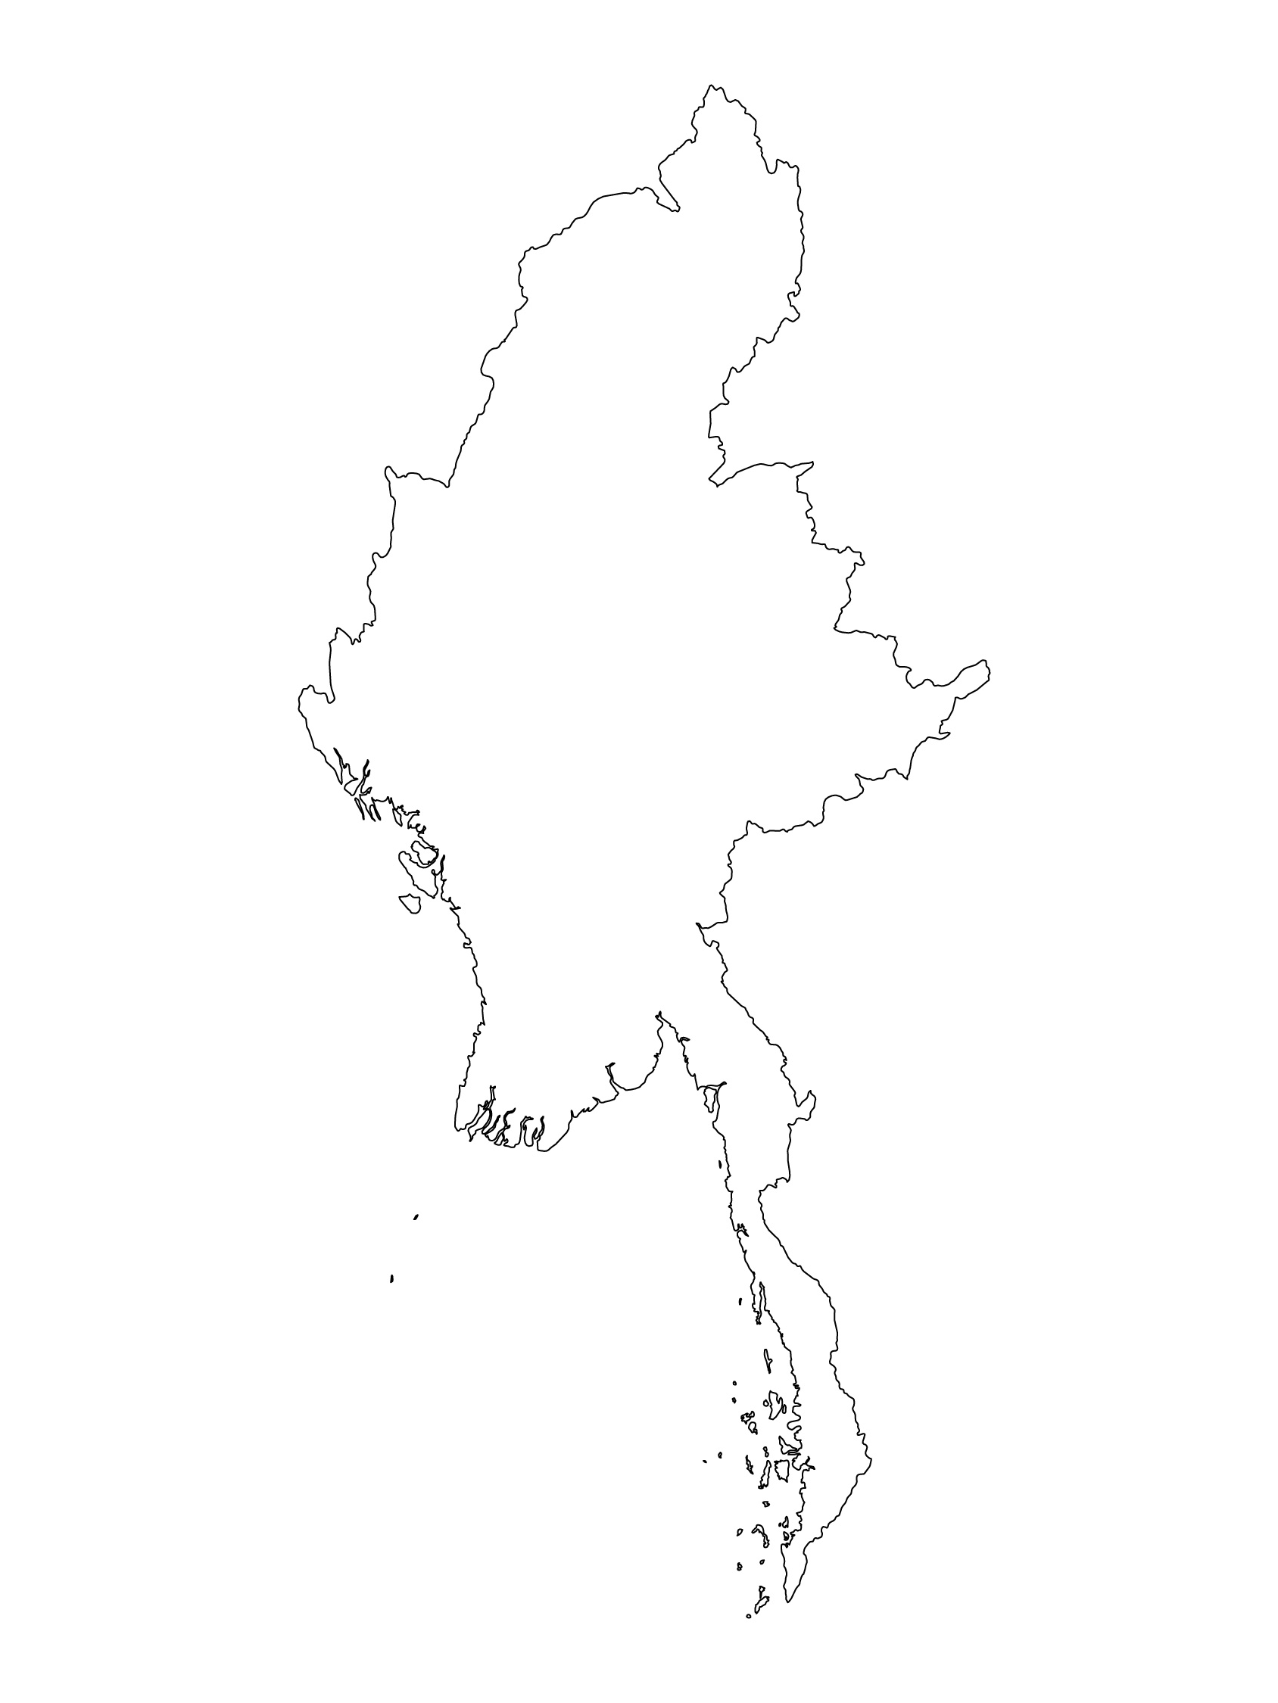
Examples from the Region
[COUNTRY NAME]
Add key presentation sentence about a specific program/project using Standard 13
Add name of organisations
Add key message / numbers
[ COUNTRY NAME]
Add key presentation sentence about a specific program/project using Standard 13
Add name of organisations
Add key message / numbers
[ COUNTRY NAME]
Add key presentation sentence about a specific program/project using Standard 13
Add name of organisations
Add key message / numbers
Notes:
Depending on the time you have for facilitation, consider adding here examples from the Region/ Country/ Response, of programming that meets the standards.
This could be a draft slide that you could update or remove if necessary.
For each example, you could add:
A short, concise, key presentation sentence about the specific program/project using Standard 13
Add the name of organisations and partners involved
Add practical lessons learnt, key actions, message or numbers, that will attract interest of your audience
Another option, if you have longer and also depending on the audience you have), this slide can be completed in an interactive way during the session.
In that case, you could:
split the groups into 2 or 3 smaller groups,
allow 15 – 20 min for them to prepare a short presentation of an example from the Region/ Country/ Response, of programming that meets the standard
in plenary, have the groups present their examples, and discuss /compare lessons learnt out of them.
If you will be sending this presentation to the participants after the training, you can fill up this slide, to keep records of the presentations.
TIP: you can use https://thenounproject.com/ to get map outlines like those.

Slide 8
Need more than the hard copy?
On the Alliance website
PDF version
Briefing & Implementation Pack
25-page Summary
E-course
YouTube videos
A gallery of illustrated Standards
👉 www.AllianceCPHA.org
On the Humanitarian Standards Partnership website
Online, interactive version
HSP App for mobile phones and tablets
👉 www.HumanitarianStandardsPartnership.org
Notes:
[Facilitators - if you can project from the internet, then we suggest you navigate people there and show them]
HSP:
1. Online handbook
2. The Humanitarian Standards Partnership App
– It is the 2nd most popular app on that site after Sphere
CPMS page:
1. Interactive handbook – our greatest resource
2. A Summary: At just 32 pages, it means that it I CPHA topline but can be used to introduce the idea of minimum standards or start child protection discussions with government colleagues or other humanitarians without overwhelming them with the huge handbook.
Alliance website:
The PDF & all materials available can be downloaded if people want to print just portions of the CPMS, on the Alliance site
The “Introduction to CPMS” Briefing Pack contains this PPT and facilitation notes, plus the 2 page Introduction handout.
A gallery of illustrated Standards
Discover our free CPMS e-course with a range of modules
Videos on the Alliance Youtube channel
ASK: What should our next steps as a team/agency/individual be?
(i.e. you might schedule a longer meeting to digest the changes and create a plan; or ask colleagues to present certain new/revised standards and their implications for the programme; or set up a training or ask Senior Management for a meeting to discuss accountability to children, etc)
[Facilitators - Printed copies – there is a small stockpile of the Handbook and Summary that the global Alliance has in Geneva; however, countries and regions are encouraged to print & manage their own copies locally. Usually, this would be done through the inter-agency Coordination structure. On request, the Alliance can share a print-ready PDF.]
Thank you so much for coming together and starting to explore the CPMS. I will follow up on the next steps we discussed. And that’s the key – the CPMS is a gift that just keeps on giving every time you open it!

