Slide 1
The Minimum Standards for Child Protection in Humanitarian Action
CPMS
SLIDE DECK
Notes:
Facilitators:
This briefing is for any potential user of the CPMS. It is geared primarily toward child protection staff, so consider broadening some questions or providing more detail, if colleagues from other sectors join you.
It is assumed that the group is about 20 people and that everyone in the room knows each other (perhaps colleagues from your agency or the CP coordination group). if not, add 5 minutes for quick introductions.
PREPARE: a flipchart with the objectives of the session
By the end of the session, participants will be able to:
Describe the content of Standard 11
Explain & Share its key messages
Demonstrate how & why to use the handbook
NOTE: if you have already done a Session on Pillar(s), Principles or other Standard(s), skip slide 2 & 8
TIP: Slides are animated -> for each click you’ll make, some few words, a title or an image will appear on the slide.
Read the corresponding notes from the facilitators notes, before showing the following content, so participants have time to process what you say, and read each point.

Slide 2
Aim of the Standards
Benchmark for CPHA.
Collaborative, inter-agency tool
Links with Core Humanitarian Standard
Contextualisation for local ownership
Purpose:
quality and accountability
impact for children’s protection and well-being
Notes:
Donors, local governments, colleagues in other sectors and our beneficiaries themselves want to know what we are doing and why. The CPMS are our benchmark. CPMS are the key way to operationalise or make real children's rights in the practice of humanitarian response.
They are a collaborative, inter-agency tool, that links with other initiatives, such as the Core Humanitarian Standard, INSPIRE and the Humanitarian Inclusion Standards
Wherever relevant, the CPMS align with INSPIRE’s 7 strategies to end violence against children – initiative’s icons are actually scattered through the text. In addition, the Core Humanitarian Standard on Quality and Accountability is highlighted in the Introduction and resonates throughout the handbook.
Contextualisation is encouraged and can create ownership of the standards at every level. It builds a deeper understanding of child protection in the specific context for a wide range of actors. National coordination groups are therefore encouraged to adapt the CPMS. Please raise it with colleagues locally and then seek the guidance of the global CPMS team. For more information, watch the short contextualization video on the Alliance’s youtube channel.
BOX: The CPMS aim at improving the quality and accountability of our programing and increasing impact for children’s protection and well-being in humanitarian action (across all contexts), by establishing common principles, evidence, prevention and goals to achieve. They provide a synthesis of good practice and learning to date.

Slide 3
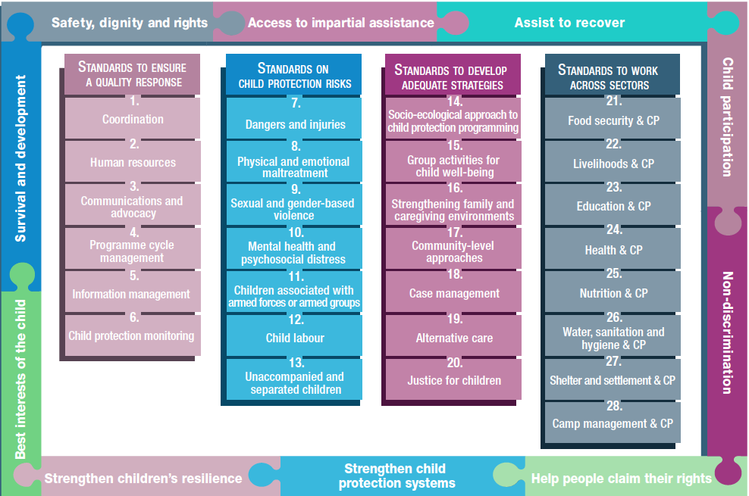
Overview
Notes:
This is an overview of the CPMS structure: there are 28 Standards across 4 pillars and 10 CPHA principles threaded throughout.
You can find this overview on the back of the CPMS handbook or in the online handbook; it’s a practical way of locating quickly a specific topic.
This presentation focuses on Standard 11: Children associated with armed forces and armed groups

Slide 4
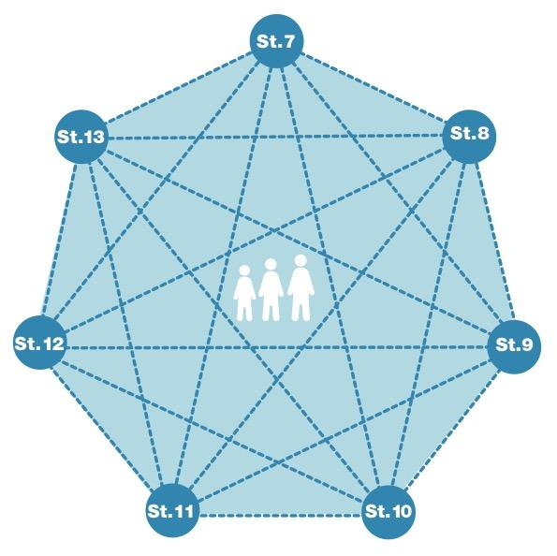
General intro to Standard 11
Part of 2nd Pillar, related to child protection risks
RISK = Nature & Extent of hazard + Vulnerability - Resilience
Emphasis on child-centred prevention of recruitment
Multi-sectoral community-based reintegration programmes
Advocacy
What different roles children are used for in armed forces & groups?
Notes:
This Standard is part of the second Pillar related to child protection risks that children may face in humanitarian settings. All the seven different risk standards are linked, as they address overlapping vulnerabilities and risks. The risks cannot be addressed in isolation.
Child protection risks are potential violations and threats to children's rights that will cause harm to children. To understand a child's risk, we need to understand the nature (type of hazard, situation, threat…) & extent of the risk and the individual child’s vulnerability to that risk, but also the family/child coping or survival strategies (meaning their resilience and ability to withstand the risk). Vulnerability is understood as the extent to which a child has characteristics that reduce his ability to withstand adverse impact. We have to record that vulnerability is specific to each person and each situation
DEF: ‘Recruitment’ refers to the compulsory, forced or unforced enlistment of any child into any armed force or armed group.
Recruitment and use deprive children of their rights and have immediate and long-term negative consequences for the socio-economic, psychological and physical health of children, families and communities. Children, including girls, who are used or recruited by armed forces or armed groups are often forced to witness, experience and commit abuse, exploitation or violence. The recruitment and use of children by armed forces or armed groups is a grave violation of child rights and international humanitarian law.
Humanitarian actors must take action to prevent recruitment and use of children and to address the immediate and long-term negative consequences for children, families and communities through multi-sectoral community-based reintegration programmes, as well as advocacy for the release of all associated children. This standard calls for an emphasis on child-centred prevention, especially protecting them from recruitment [→ the prevention icon]
Examples of drivers for child association: Reduced presence of child protection and humanitarian actors and security personnel; weakened community structures; reduced parental supervision and care; economic impacts of the crisis pushing children to search for food, basic goods, or livelihood opportunities; reduced access to support services…
Advocacy: Where child recruitment and use are not yet prohibited by national law, advocate for such legislation. Where they are prohibited, authorities and stakeholders (including, where appropriate, armed forces or groups) should be encouraged to fulfil their legal obligations. All parties to conflict should end recruitment and use of children in armed conflict and release all associated girls and boys to child protection authorities immediately and without any preconditions.
This standard points the need to establish and support case management services, to screen, identify, verify and document children; provide information about available support services; accompany release or disengagement processes; work on tracing and reunification & support reintegration [→ the case management icon]
Discussion Prompt: What different roles children are used for in groups?
Children are used by armed forces or armed groups in many different roles. These children are often forced to witness, experience and commit abuse, exploitation or violence.
They can be used as:
Combatant
For sexual purposes
Checkpoint or prison guards
Cook or domestic labourers
Minelayer
Spy
Human shield
Porter
Suicide bomber
Other purposes to be contextualized based on your context

Slide 5
“All children are protected from recruitment and use by armed forces or armed groups, are released and are effectively reintegrated after recruitment and use in all contexts of armed conflict.”
Human rights violations
Family separation / unity
Release
Appropriate support services
Prevention
Notes:
Standard 11 states: “All children are protected from recruitment and use by armed forces or armed groups, are released and are effectively reintegrated after recruitment and use in all contexts of armed conflict.”
Children formerly associated with armed groups should be treated as victims of human rights violations. They should be protected from detention, investigation, prosecution, torture or ill treatment; released if detained
For children who are over the age of criminal responsibility and who are alleged to have committed crimes while associated with armed forces or groups, alternatives to detention should be encouraged. They should only be detained in accordance with international juvenile justice standards.
Without creating stigma, key community members and groups should identify and target any children who are vulnerable to family separation, recruitment or re-recruitment. Social support and assistance programmes for prevention should encourage family unity.
All children associated with armed forces or groups should be released immediately and without any preconditions, even during armed conflict, without depending on the end of hostilities or announcement of peace (or any other conditions)
All children leaving armed forces or groups should receive appropriate health, education and psychosocial support services. Children may need clothes or hygiene articles upon leaving an armed force or group. These items should be provided in accordance with accepted cultural, contextual and family/community standards. Cash and voucher assistance to children formerly associated with armed forces or groups is not recommended: it could become a pull factor for other children and families.
Prevention actions possible:
Education and vocational programs & trainings
income generating opportunities;
access to social protection and livelihood opportunities
school feeding programs support
individual, family, or community-level support through adapted case management or psychosocial support services to children at risk of recruitment or undergoing reintegration.
material assistance (after assessing and mitigating risks of stigma or unintended harm)

Slide 6
Steps of DDR programming
Child-specific interventions
Awareness of rights and responsibilities
Engagement with children, caregivers, and communities
Comprehensive Case Management
Significant psychosocial support and other holistic care
Safe social and economic reintegration
Screening, identification and age verification
Release & Emergency services
Interim (family-based) care
Family tracing and reunification
Reintegration
Notes:
Ongoing screening, identification and age verification can determine when there are children within the ranks of armed forces or groups. Children must be documented immediately after exiting armed forces or groups using child-friendly interview techniques & a mixed team of male and female caseworkers.
Release & Emergency Services: shelter, food, health care, and other urgent supplies and services for children who exit from armed groups and are not already reunited or living in a family situation.
Many children should be able to return to their families and communities or be integrated into family-based care soon after release. Interim care should be provided for those who cannot immediately return to their families or whose families need to be traced. Family-based interim care should be prioritised above institutional care such as transit/interim care centres.
Preparations to reunify children must mitigate risks and threats of discrimination, violence and further recruitment. Before reunification, caseworkers should assess families’ willingness and ability to accept a child and determine whether reunification is in the child’s best interests
Reintegration activities seek to help (a) children transition from a military environment and develop productive lives within communities and (b) community members view and treat released children the same as other children. The reintegration process should be individually focused and community-based. Community-level reintegration may include peace-building and social cohesion activities, awareness raising and behaviour change, and community-wide education and socio-economic initiatives.
Child-specific DDR interventions:
- Awareness of rights and responsibilities
- Engagement with children, caregivers, and communities
- Comprehensive Case Management : ensure a holistic response to CAAFAG is given, by providing tailored support and monitoring children’s needs
- Significant psychosocial support and other holistic care: within child-friendly Spaces and schools & through community-based child protection committees
- Safe social and economic reintegration: enrollment in formal schools (primary and secondary), Family counseling, Medical check ups, Community outreach, Home visits; Formal vocational training (sewing, carpentry, metal wielding, electrical, etc.), Technical training (business, agriculture, etc.), small scale businesses to increase household income, income generating activities

Slide 7
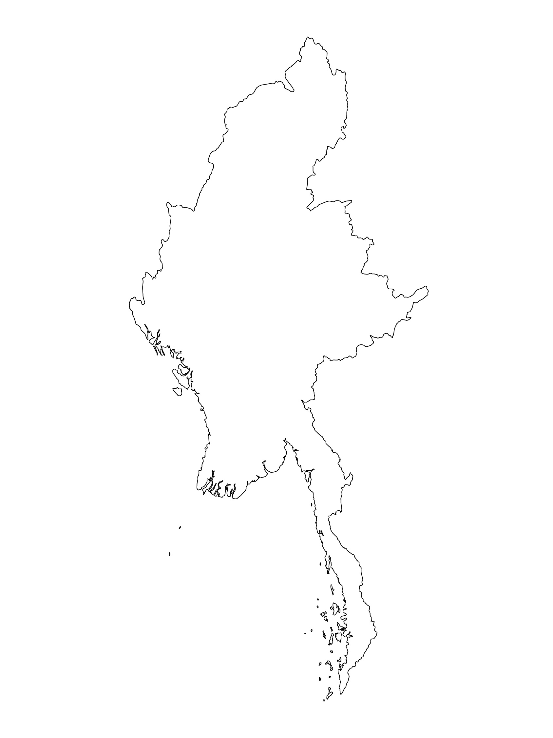
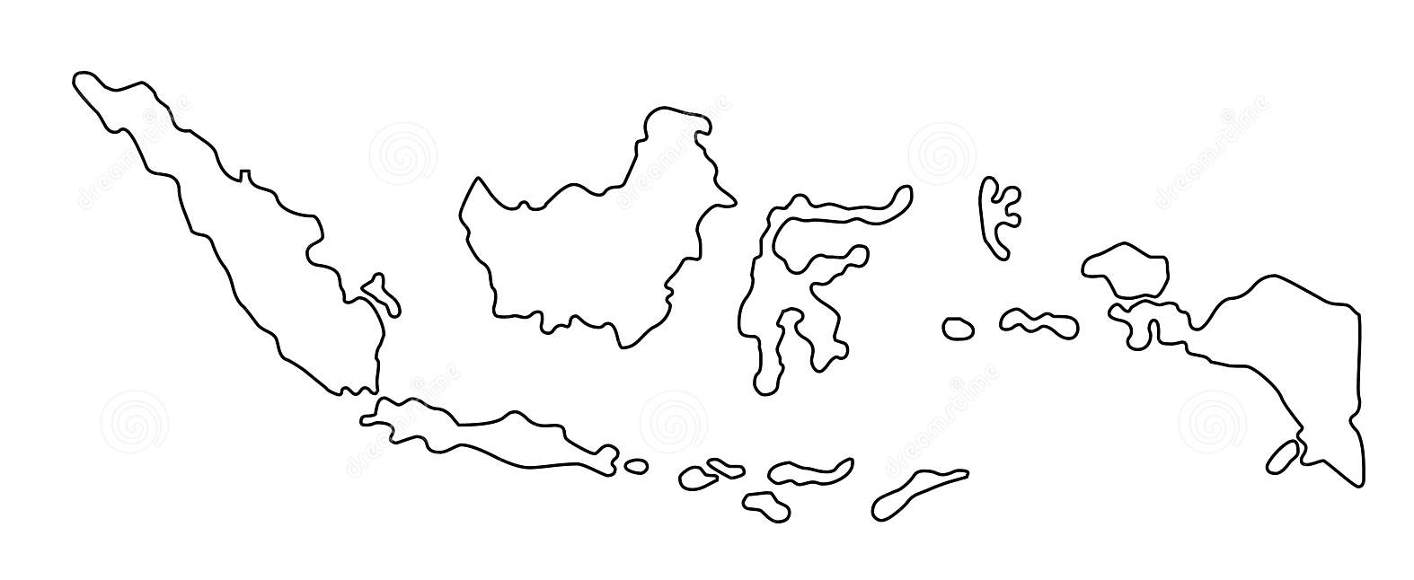
Examples from the Region
[COUNTRY NAME]
Add key presentation sentence about a specific program/project using Standard 11
Add name of organisations
Add key message / numbers
[ COUNTRY NAME]
Add key presentation sentence about a specific program/project using Standard 11
Add name of organisations
Add key message / numbers
[ COUNTRY NAME]
Add key presentation sentence about a specific program/project using Standard 11
Add name of organisations
Add key message / numbers
Notes:
Depending on the time you have for facilitation, consider adding here examples from the Region/ Country/ Response, of programming that meets the standards.
This could be a draft slide that you could update or remove if necessary.
For each example, you could add:
A short, concise, key presentation sentence about the specific program/project using Standard 11
Add the name of organisations and partners involved
Add practical lessons learnt, key actions, message or numbers, that will attract interest of your audience
Another option, if you have longer (and also depending on the audience you have), this slide can be completed in an interactive way during the session.
In that case, you could:
split the groups into 2 or 3 smaller groups,
allow 15 – 20 min for them to prepare a short presentation of an example from the Region/ Country/ Response, of programming that meets the standard
in plenary, have the groups present their examples, and discuss /compare lessons learnt out of them.
If you will be sending this presentation to the participants after the training, you can fill up this slide, to keep records of the presentations.
TIP: you can use https://thenounproject.com/ to get map outlines like those.

Slide 8
Need more than the hard copy?
On the Alliance website
PDF version
Briefing & Implementation Pack
25-page Summary
E-course
YouTube videos
A gallery of illustrated Standards
👉 www.AllianceCPHA.org
On the Humanitarian Standards Partnership website
Online, interactive version
HSP App for mobile phones and tablets
👉 www.HumanitarianStandardsPartnership.org
Notes:
[Facilitators - if you can project from the internet, then we suggest you navigate people there and show them]
HSP:
1. Online handbook
2. The Humanitarian Standards Partnership App
– It is the 2nd most popular app on that site after Sphere
CPMS page:
1. Interactive handbook – our greatest resource
2. A Summary: At just 32 pages, it means that it I CPHA topline but can be used to introduce the idea of minimum standards or start child protection discussions with government colleagues or other humanitarians without overwhelming them with the huge handbook.
Alliance website:
The PDF & all materials available can be downloaded if people want to print just portions of the CPMS, on the Alliance site
The “Introduction to CPMS” Briefing Pack contains this PPT and facilitation notes, plus the 2 page Introduction handout.
A gallery of illustrated Standards
Discover our free CPMS e-course with a range of modules
Videos on the Alliance Youtube channel
ASK: What should our next steps as a team/agency/individual be?
(i.e. you might schedule a longer meeting to digest the changes and create a plan; or ask colleagues to present certain new/revised standards and their implications for the programme; or set up a training or ask Senior Management for a meeting to discuss accountability to children, etc)
[Facilitators - Printed copies – there is a small stockpile of the Handbook and Summary that the global Alliance has in Geneva; however, countries and regions are encouraged to print & manage their own copies locally. Usually, this would be done through the inter-agency Coordination structure. On request, the Alliance can share a print-ready PDF.]
Thank you so much for coming together and starting to explore the CPMS. I will follow up on the next steps we discussed. And that’s the key – the CPMS is a gift that just keeps on giving every time you open it!

