Slide 1
The Minimum Standards for Child Protection in Humanitarian Action
CPMS
SLIDE DECK
Notes:
Facilitators:
This briefing is for any potential user of the CPMS. It is geared primarily toward child protection staff, so consider broadening some questions or providing more detail, if colleagues from other sectors join you.
It is assumed that the group is about 20 people and that everyone in the room knows each other (perhaps colleagues from your agency or the CP coordination group). if not, add 5 minutes for quick introductions.
PREPARE: a flipchart with the objectives of the session
By the end of the session, participants will be able to:
Describe the content of Standard 10
Explain & Share its key messages
Demonstrate how & why to use the handbook
NOTE: if you have already done a Session on Pillar(s), Principles or other Standard(s), skip slide 2 & 8
TIP: Slides are animated -> for each click you’ll make, some few words, a title or an image will appear on the slide.
Read the corresponding notes from the facilitators notes, before showing the following content, so participants have time to process what you say, and read each point.

Slide 2
Aim of the Standards
Benchmark for CPHA.
Collaborative, inter-agency tool
Links with Core Humanitarian Standard
Contextualisation for local ownership
Purpose:
quality and accountability
impact for children’s protection and well-being
Notes:
Donors, local governments, colleagues in other sectors and our beneficiaries themselves want to know what we are doing and why. The CPMS are our benchmark. CPMS are the key way to operationalise or make real children's rights in the practice of humanitarian response.
They are a collaborative, inter-agency tool, that links with other initiatives, such as the Core Humanitarian Standard, INSPIRE and the Humanitarian Inclusion Standards
Wherever relevant, the CPMS align with INSPIRE’s 7 strategies to end violence against children – initiative’s icons are actually scattered through the text. In addition, the Core Humanitarian Standard on Quality and Accountability is highlighted in the Introduction and resonates throughout the handbook.
Contextualisation is encouraged and can create ownership of the standards at every level. It builds a deeper understanding of child protection in the specific context for a wide range of actors. National coordination groups are therefore encouraged to adapt the CPMS. Please raise it with colleagues locally and then seek the guidance of the global CPMS team. For more information, watch the short contextualization video on the Alliance’s youtube channel.
BOX: The CPMS aim at improving the quality and accountability of our programing and increasing impact for children’s protection and well-being in humanitarian action (internal displacement and refugee contexts), by establishing common principles, evidence, prevention and goals to achieve. They provide a synthesis of good practice and learning to date.

Slide 3
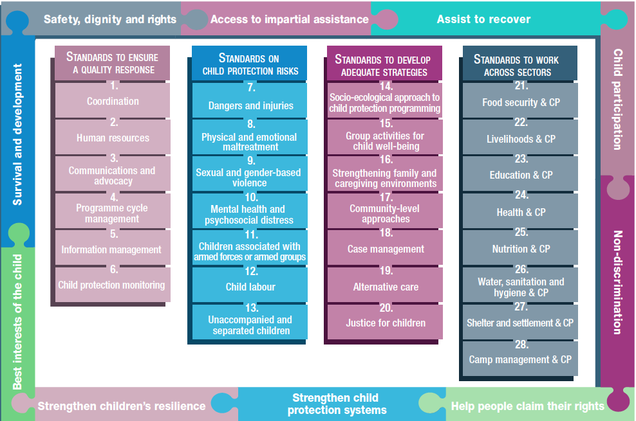
Overview
Notes:
This is an overview of the CPMS structure: there are 28 Standards across 4 pillars and 10 CPHA principles threaded throughout.
You can find this overview on the back of the CPMS handbook or in the online handbook; it’s a practical way of locating quickly a specific topic.
This presentation focuses on Standard 10: Mental health and psychosocial distress

Slide 4
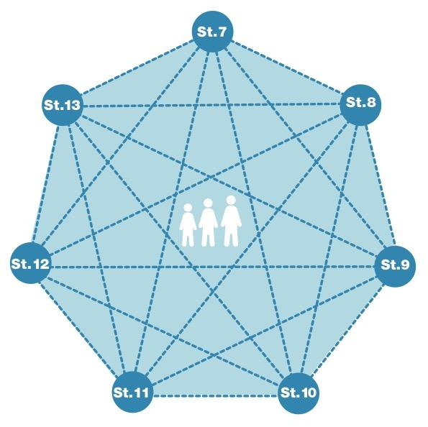
General intro to Standard 10
Part of 2nd Pillar, related to child protection risks
RISK = Nature & Extent of hazard + Vulnerability - Resilience
Psychological suffering and social disruption
Prevent/ reduce distress
Community and family level supports
Across all ages and all stages of child development
Context-dependent
What are major sources of distress ?
Notes:
This Standard is part of the second Pillar related to child protection risks that children may face in humanitarian settings. All the seven different risk standards are linked, as they address overlapping vulnerabilities and risks. The risks cannot be addressed in isolation.
Child protection risks are potential violations and threats to children's rights that will cause harm to children. To understand a child's risk, we need to understand the nature (type of hazard, situation, threat…) & extent of the risk and the individual child’s vulnerability to that risk, but also the family/child coping or survival strategies (meaning their resilience and ability to withstand the risk). Vulnerability is understood as the extent to which a child has characteristics that reduce his ability to withstand adverse impact. We have to record that vulnerability is specific to each person and each situation
Humanitarian crises can cause immediate and long-term psychological suffering and social disruption among children and caregivers, who can develop mental health conditions that require specialised support.
Humanitarian actors must prioritise interventions that help reduce children and caregivers’ distress, promote their resilience, and where appropriate, link children to specialised supports.
The Standard points to the importance of community level supports, and programming across all ages and all stages of child development. [→ the early childhood and adolescent icons]
Also stresses the importance of tailoring the delivery of psychosocial interventions to the nature of the crisis.
I.e. For example, group activities may not be possible during infectious disease outbreaks (may need to opt for home-based, peer-to-peer and one-on-one care). [→ infectious disease outbreaks icons]
I.e. In refugee or internal displacement settings, community structures may be weakened (need to encourage community cohesion as a first step) [→ displacement icon]
Discussion Prompt: What are the major sources of distress?
Major sources of distress include:
Exposure to distressing events;
Death of or separation from family members;
Lack of basic services, accurate information, safety and security;
Displacement; and
Weakened family and community networks and support systems.

Slide 5
“Children and their caregivers experience improved mental health and psychosocial well-being.”
Stages of child development
Family-level & community-level interventions
Psychological first aid
Specialised services
Notes:
Standard 10 states: “Children and their caregivers experience improved mental health and psychosocial well-being.”
DEF: ‘Mental health and psychosocial support’ (MHPSS) refers to any type of support that protects or promotes psychosocial well-being and prevents or treats mental health conditions (IASC Guidelines on MHPSS in Emergency Settings 2007).
Child well-being (according to the CPMS): A dynamic, subjective and objective state of physical, cognitive, emotional, spiritual and social health in which children:
Are safe from abuse, neglect, exploitation and violence;
Have their basic needs, including survival and development, met;
Are connected to and cared for by primary caregivers;
Have the opportunity for supportive relationships with relatives, peers, teachers, community members and society at large; and
Have the opportunities and elements required to exercise their agency based on their evolving capacities.
-> In any case, wellbeing needs to be defined and contextualized: The IASC or CPMS definitions can be used, but one can also use their specific framework, ensuring that it is contextualized.
All children’s cognitive, social and emotional functioning continues to develop beyond the age of 18 years. Therefore, mental health and psychosocial support programmes must be provided and tailored to all children at all ages and stages of development as follows:
- Pre- and post-natal: support to pregnant women, expectant fathers and families with infants.
- Early childhood: support for children’s rapidly developing brains and their positive attachment to caregivers.
Middle childhood and adolescence: support for ongoing development and social and emotional changes brought about by significant transitions. Adolescents are at increased risk of experiencing social and psychological problems. Social stress is likely to have a disproportionate impact during this phase of life.
Caregivers, families and communities are the most important sources of protection and well-being for children. Family-level interventions that improve caregiver well-being and promote healthy childhood development can promote caregiver self-care; support positive parenting; teach parents to support children in distress; strengthen family attachments; support economic stability; promote social cohesion; prevent stigma and discrimination
Psychological first aid describes a humane, supportive first response to help people feel safe, connected, calm and hopeful; to help them access social, physical and emotional support; and feel able to help themselves and their communities. It can be learned and provided by children, community members and humanitarians.
Specialised services are necessary for members of the affected population with more severe or complex mental health conditions. If qualified and supervised staff are available, specialised services may be provided as part of a child protection programme. If specialised services are not available, child protection actors should provide thorough case management and other interventions (such as family-strengthening support and community-level support) that can prevent further harm to children’s and caregivers’ well-being.

Slide 6
MHPSS: Pyramid of services
multi-­layered system
complementary supports
different groups = different needs
SOCIAL CONSIDERATIONS
Notes:
The standard is based on the IASC Guidelines on Mental Health and Psychosocial Support (MHPSS) in Emergency Settings, which provide an overall framework for Mental Health and Psychosocial Support.
It calls for organizing a multi-­layered system of complementary supports that meets the needs of different groups
Basic services and security:
Group: the well‐being of all people should be protected through the (re) establishment of security, adequate governance and services that address basic physical needs
Support: Participatory, safe, and socially appropriate delivery of basic, multisectoral services and security that supports the dignity and well-being of all children and community-members.
Community and family supports:
Group: A smaller amount of people will be able to maintain their mental health and psychosocial well­‐being if they receive help in accessing key community and family supports
Support: Inclusive activities (usually provided by community providers) that support the recovery, resilience, mental health and psychosocial well-being of children, families and communities.
Focused non­‐specialized supports:
Group: An even smaller group of people requires more focused individual, family or group interventions by trained and supervised workers (who may not have had years of training in specialized care
Support: Targeted, structured activities provided by trained and supervised workers (usually not mental health specialists) to individuals, families, or groups with mental health conditions or continued distress.
Specialized services:
Group: The top of the pyramid represents people, who are suffering despite the supports already mentioned in the first levels of the pyramid require special assistance, such as psychological and psychiatric care
Support: Services provided by mental health clinicians and social service professionals to those with severe mental health conditions or distress beyond the scope of general social and health care services.

Slide 7
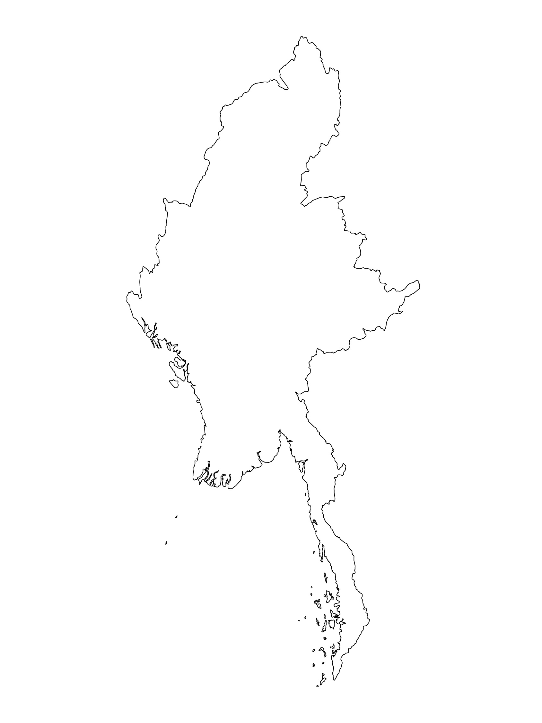
Examples from the Region
[COUNTRY NAME]
Add key presentation sentence about a specific program/project using Standard 10
Add name of organisations
Add key message / numbers
[ COUNTRY NAME]
Add key presentation sentence about a specific program/project using Standard 10
Add name of organisations
Add key message / numbers
[ COUNTRY NAME]
Add key presentation sentence about a specific program/project using Standard 10
Add name of organisations
Add key message / numbers
Notes:
Depending on the time you have for facilitation, consider adding here examples from the Region/ Country/ Response, of programming that meets the standards.
This could be a draft slide that you could update or remove if necessary.
For each example, you could add:
A short, concise, key presentation sentence about the specific program/project using Standard 10
Add the name of organisations and partners involved
Add practical lessons learnt, key actions, message or numbers, that will attract interest of your audience
Another option, if you have longer (and also depending on the audience you have), this slide can be completed in an interactive way during the session.
In that case, you could:
split the groups into 2 or 3 smaller groups,
allow 15 – 20 min for them to prepare a short presentation of an example from the Region/ Country/ Response, of programming that meets the standard
in plenary, have the groups present their examples, and discuss /compare lessons learnt out of them.
If you will be sending this presentation to the participants after the training, you can fill up this slide, to keep records of the presentations.
TIP: you can use https://thenounproject.com/ to get map outlines like those.

Slide 8
Need more than the hard copy?
On the Alliance website
PDF version
Briefing & Implementation Pack
25-page Summary
E-course
YouTube videos
A gallery of illustrated Standards
👉 www.AllianceCPHA.org
On the Humanitarian Standards Partnership website
Online, interactive version
HSP App for mobile phones and tablets
👉 www.HumanitarianStandardsPartnership.org
Notes:
[Facilitators - if you can project from the internet, then we suggest you navigate people there and show them]
HSP:
1. Online handbook
2. The Humanitarian Standards Partnership App
– It is the 2nd most popular app on that site after Sphere
CPMS page:
1. Interactive handbook – our greatest resource
2. A Summary: At just 32 pages, it means that it I CPHA topline but can be used to introduce the idea of minimum standards or start child protection discussions with government colleagues or other humanitarians without overwhelming them with the huge handbook.
Alliance website:
The PDF & all materials available can be downloaded if people want to print just portions of the CPMS, on the Alliance site
The “Introduction to CPMS” Briefing Pack contains this PPT and facilitation notes, plus the 2 page Introduction handout.
A gallery of illustrated Standards
Discover our free CPMS e-course with a range of modules
Videos on the Alliance Youtube channel
ASK: What should our next steps as a team/agency/individual be?
(i.e. you might schedule a longer meeting to digest the changes and create a plan; or ask colleagues to present certain new/revised standards and their implications for the programme; or set up a training or ask Senior Management for a meeting to discuss accountability to children, etc)
[Facilitators - Printed copies – there is a small stockpile of the Handbook and Summary that the global Alliance has in Geneva; however, countries and regions are encouraged to print & manage their own copies locally. Usually, this would be done through the inter-agency Coordination structure. On request, the Alliance can share a print-ready PDF.]
Thank you so much for coming together and starting to explore the CPMS. I will follow up on the next steps we discussed. And that’s the key – the CPMS is a gift that just keeps on giving every time you open it!

