Slide 1
The Minimum Standards for Child Protection in Humanitarian Action
CPMS
SLIDE DECK
Notes:
Facilitators:
This briefing is for any potential user of the CPMS. It is geared primarily toward child protection staff, so consider broadening some questions or providing more detail, if colleagues from other sectors join you.
It is assumed that the group is about 20 people and that everyone in the room knows each other (perhaps colleagues from your agency or the CP coordination group). if not, add 5 minutes for quick introductions.
PREPARE: a flipchart with the objectives of the session
By the end of the session, participants will be able to:
Describe the structure and content of the CPMS, especially pillar 1
Demonstrate how & why to use the handbook
NOTE: if you have already done a Session on other Pillar(s), skip slide 2 & 8
TIP: Slides are animated -> for each click you’ll make, a few words, a title or an image will appear on the slide.
Read the corresponding notes from the facilitators notes, before showing the following content, so participants have time to process what you say, and read each point.

Slide 2
Aim of the Standards
Benchmark for CPHA.
Collaborative, inter-agency tool
Links with Core Humanitarian Standard
Contextualisation for local ownership
Purpose:
quality and accountability
impact for children’s protection and well-being
Notes:
Donors, local governments, colleagues in other sectors and our beneficiaries themselves want to know what we are doing and why. The CPMS are our benchmark. They are the key way to operationalise or make real children's rights in the practice of humanitarian response.
They are a collaborative, inter-agency tool, that links with other initiatives, such as the Core Humanitarian Standard, INSPIRE and the Humanitarian Inclusion Standards
Wherever relevant, the CPMS align with INSPIRE’s 7 strategies to end violence against children – that initiative’s icons are scattered through the text. In addition, the Core Humanitarian Standard on Quality and Accountability is highlighted in the Introduction and resonates throughout the handbook.
Contextualisation (adaptation to your specific context) is encouraged and can create ownership of the standards at every level. It builds a deeper understanding of child protection in the specific context for a wide range of actors. National coordination groups are therefore encouraged to adapt the CPMS. Please raise it with colleagues locally and then seek the guidance of the global CPMS team. For more information, watch the contextualization video on the Alliance’s youtube channel.
BOX: The CPMS aim at improving the quality and accountability of our programing and increasing impact for children’s protection and well-being in humanitarian action (across all contexts), by establishing common principles, evidence, prevention and goals. They provide a synthesis of good practice and learning to date.

Slide 3
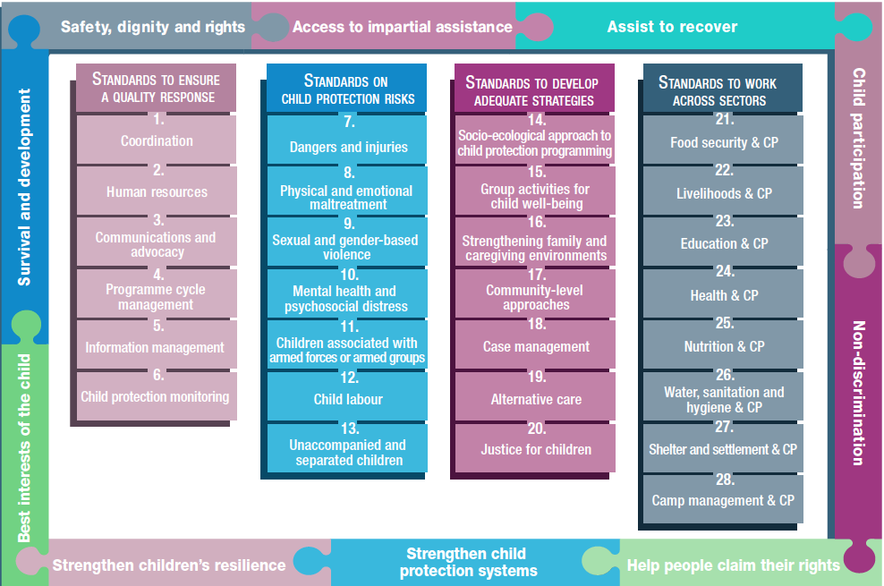
Overview
Notes:
This is an overview of the CPMS structure: there are 28 Standards across 4 pillars and 10 CPHA principles threaded throughout.
You can find this overview on the back of the CPMS handbook or in the online handbook; it’s a practical way of locating quickly a specific topic.
This presentation focuses on Pillar 1: Standards to Ensure a Quality Response

Slide 4
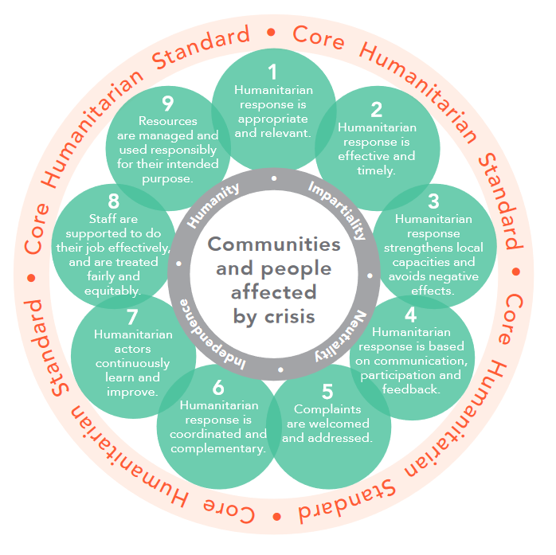
Pillar 1 – to ensure a quality response
Essential to ANY quality child protection programming
Applicable at all times
Applicable in all contexts/settings
In line w/ CHS
Throughout: Strong emphasis on child safeguarding and PSEA
Notes:
This first group of Standards relate to quality response: they are common across all areas of child protection programming.
They are applicable in all situations and contexts, during prevention, preparedness and response phases. They are ALL fundamental to reach the quality we as practitioners are aiming for.
These standards should be used in conjunction with all the rest of the Standards (7–28) & the CPMS principles
They are directly related to and complementary to the Core Humanitarian Standard on Quality and Accountability (CHS).
Equally, the CPMS highlights the importance of child safeguarding and the prevention of sexual exploitation and abuse and flags them throughout the documents with the use of specific icons.
Discussion prompt: Can anyone name standards under Pillar 1?
-----------------------**--------------------
Facilitator notes, to explain in more detail the content of the slide:
Background info on the 9 commitments of the CHS :
The Core Humanitarian Standard on Quality and Accountability (CHS) sets out Nine Commitments that organisations and individuals involved in humanitarian response can use to improve the quality and effectiveness of the assistance they provide. It also facilitates greater accountability to communities and people affected by crisis: knowing what humanitarian organisations have committed to will enable them to hold those organisations to account. As a core standard, the CHS describes the essential elements of principled, accountable and high-quality humanitarian action.
Communities and people affected by crisis receive assistance appropriate and relevant to their needs.
Quality Criterion: Humanitarian response is appropriate and relevant.
2. Communities and people affected by crisis can expect that the organisations assisting them are managing resources effectively, efficiently and ethically.
Quality Criterion: Resources are managed and used responsibly for their intended purpose.
3. Communities and people affected by crisis can expect delivery of improved assistance as organisations learn from experience and reflection.
Quality Criterion: Humanitarian actors continuously learn and improve.
4. Communities and people affected by crisis receive coordinated, complementary assistance.
Quality Criterion: Humanitarian response is coordinated and complementary.
5. Communities and people affected by crisis have access to safe and responsive mechanisms to handle complaints.
Quality Criterion: Complaints are welcomed and addressed.
6. Communities and people affected by crisis know their rights and entitlements, have access to information and participate in decisions that affect them.
Quality Criterion: Humanitarian response is based on communication, participation and feedback.
7. Communities and people affected by crisis are not negatively affected and are more prepared, resilient and less at-risk as a result of humanitarian action. Quality Criterion: Humanitarian response strengthens local capacities and avoids negative effects.
8. Communities and people affected by crisis have access to the humanitarian assistance they need at the right time.
Quality Criterion: Humanitarian response is effective and timely.
9. Communities and people affected by crisis receive the assistance they require from competent and well-managed staff and volunteers.
Quality Criterion: Staff are supported to do their job effectively, and are treated fairly and equitably.

Slide 5
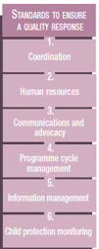
Pillar 1 – description of the Standards
St. 1: Coordination
Effective/coherent and principled responses
Inter-agency or multi-sectoral response
Shared responsibility
St. 2 : Human Resources
Skills and expertise needed
HR processes, procedures and policies
Safeguarding
St. 3: Communications & advocacy
Dignity, best interests and safety
Children’s voices and empowerment
Notes:
[FACILITATORS: Depending on your participants, their specific area of interest, your programming priorities, your context, or the time you have to facilitate, you may want select one or two keys standard under each pillar
This might be very familiar for your audience or something quite new, so please prepare your comments accordingly]
Standard 1: Coordination
Calls for everyone involved in child protection to agree on a shared set of objectives and division of labour, and to coordinate actions to protect all affected children in a timely, efficient manner. This helps to ensure that the humanitarian responses we implement on the ground is predictable, effective, timely, efficient, coherent and principled.
It helps create an inter-agency or multi-sectoral response that strengthens child protection systems in the long run.
Different coordination structures exisit in different contexts (refugees and People of Concern / IDP or mixed situations) [→ the displacement icon]. Regardless of context, we should have some coordination between actors. It is a shared responsibility. National and local actors have a critical role to play in coordination, to link with, build on, or support existing coordination and response mechanisms, and strengthen national and local ownership and capacities.
– for more info on the different coordination structure, please refer to St 1 Deck.
Link with Commitment Six of the Core Humanitarian Standard.
Standard 2: Human resources.
Child protection services are delivered by staff and associates who have proven competence in their areas of work & have developed the skills and expertise needed to do their work
This standard puts a lot of focus on HR processes, procedures and policies that promote measures to protect children and community members from maltreatment and harm by humanitarian workers: all organisations should have a ‘child safeguarding’ or ‘child protection’ policy, procedures and an implementation plan that seek to prevent staff, operations or programmes from harming children. They also need to implement simple, accessible, child-friendly, anonymous programme feedback and reporting mechanisms at each project site.
[→ the safeguarding icon]
Link with Commitment 8 of the Core Humanitarian Standard, which describes the need to support staff to do their jobs effectively and to treat staff fairly and equitably.
Standard 3: Communications and advocacy.
Child protection issues are advocated for and communicated with respect for children’s dignity, best interests and safety, prioritising the principles of do no harm; ensuring confidentiality, data protection supporting child protection
Effective communications and advocacy – including text, images, audio, video and other channels – can support children’s self-expression, protection and empowerment.
This Standard links especially with the question of prevention: risk assessments must be conducted prior to communications and advocacy work, to identify and mitigate any potential negative impacts on children, families, and communities. Campaigns should also use local communication methods, contextualised messages, and should promote protective and safe behaviours
[→ the prevention icon]
It relates to the Core Humanitarian Standard (CHS) Commitment 4 that describes the need for accurate, ethical and respectful external communications.

Slide 6
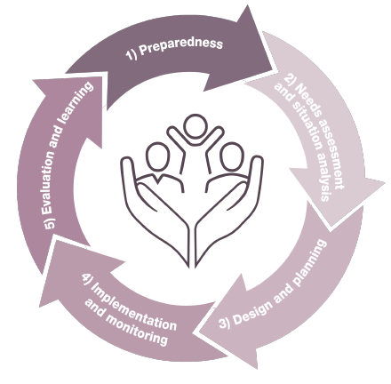
Pillar 1 – description of the Standards
St. 5: IM
Child protection-focused IM guidance
Ethical concerns
PIM Framework
St. 4: PCM
CP focus to PCM
Processes and methodologies to design, plan, manage, monitor, and evaluate
Assessment of risks and needs
Dignity, inclusion, participation
St. 6: CP Monitoring
CP risks, violations and capacities
Principles of monitoring
Secondary Data collection
Notes:
[FACILITATORS: Depending on your public, their specific area of interest, your programming priorities, your context, or the time you have to facilitate, you may want select one or two keys standard under each pillar
This might be very familiar for your audience or something quite new, so please prepare your comments accordingly]
Standard 4: Programme cycle management.
DEFINITION: Programme cycle management is the cyclical process of designing, planning, managing, monitoring and evaluating programmes, through structured processes and methodologies that build on existing capacities and resources, and address evolving child protection risks and needs. Based on learning and evidence generated through the 5 steps, programming should be continuously adapted. (see image of the programme cycle)
This standard brings a child protection focus to programme cycle management by including considerations related to child development and child rights in humanitarian action.
It also put emphasis on the importance of assessment and situational analysis of needs and risks: assessments are an integral part of any situation analysis process, to inform initial emergency programming and funding priorities (initial or rapid assessments) & collect the detailed information needed for holistic programmes (more comprehensive assessments). Those assessments must be contextualized and participatory.
3 principles are key to this Standard: the dignity and wellbeing of affected populations is strongly impacted by the design of the humanitarian response; affected populations, including children, should be consulted throughout the programme cycle and children who are discriminated against or at risk of discrimination should be included thoroughly in consultations.
This Standard links especially with the approach of prevention, intending to identify, mitigate any risks programming might directly or indirectly cause (w/ data collection for instance), when doing proper risk & needs assessments and situational analyses, and considering preparedness actions. You can also identify protective factors to help prevent and mitigate them [→ the prevention icon]
It aligns with the Core Humanitarian Standard, as a whole
Standard 5: Information management.
This standard provides child protection-focused information management guidance that is intended to complement existing information management tools and trainings.
It details the ethical concerns to keep in mind when processing, analysing and sharing data and information: it should be made anonymous; only be shared according to contextualised data protection and information-sharing protocols; should be up-to-date, and necessary/meaningful ; should respect confidentiality and CP principles ; collection must be technically and ethically sound; take into account the cultural practices and norms ; always with informed consent/assent…
Used to strengthen coordination, inform strategic decision-making, programme cycle management and support advocacy.
Complements the Protection Information Management (PIM) Framework & Protection Information Management guidance – for more info on the different documents, please refer to St 5 Deck.
Standard 6: Child protection monitoring.
DEF: Child protection situation monitoring refers to the regular and systematic examination (monitoring) of child protection risks, violations and capacities in a specific humanitarian context. The purpose is to produce situational evidence on child protection risks and existing response capacities to inform and adapt the response. Response monitoring is the ongoing and coordinated measurement of the humanitarian response in a humanitarian context, i.e. activities planned and carried out by humanitarian actors.
The collection, management, analysis and use must be done in a principled & safe manner. The design, implementation and evaluation of child protection monitoring systems should follow the PIM principles: People-centred and inclusive; Do no harm; Defined purpose; Informed consent/assent and confidentiality; Data responsibility, protection and security; Competency and capacity; Impartiality; and Coordination and collaboration. These principles must be applied in addition to the CPMS Principles.
Secondary data is any information taken from existing sources of information such as reports, assessment data, case management data, etc. Through a mix of quantitative and qualitative information sources, a preliminary situation analysis of child protection needs and capacities can be generated. A secondary data review can help identify existing data and information, potential gaps and appropriate methods for addressing those gaps.
This Standard links especially with the approach of prevention, intending to mitigate any risks to children and their families when collecting, processing and keeping records [→ the prevention icon]
[For more info on CP monitoring, check St 6 deck and the Monitoring Toolkit at: https://alliancecpha.org/en/system/tdf/library/attachments/monitoring_toolkit_low_res.pdf?file=1&type=node&id=30920)

Slide 7
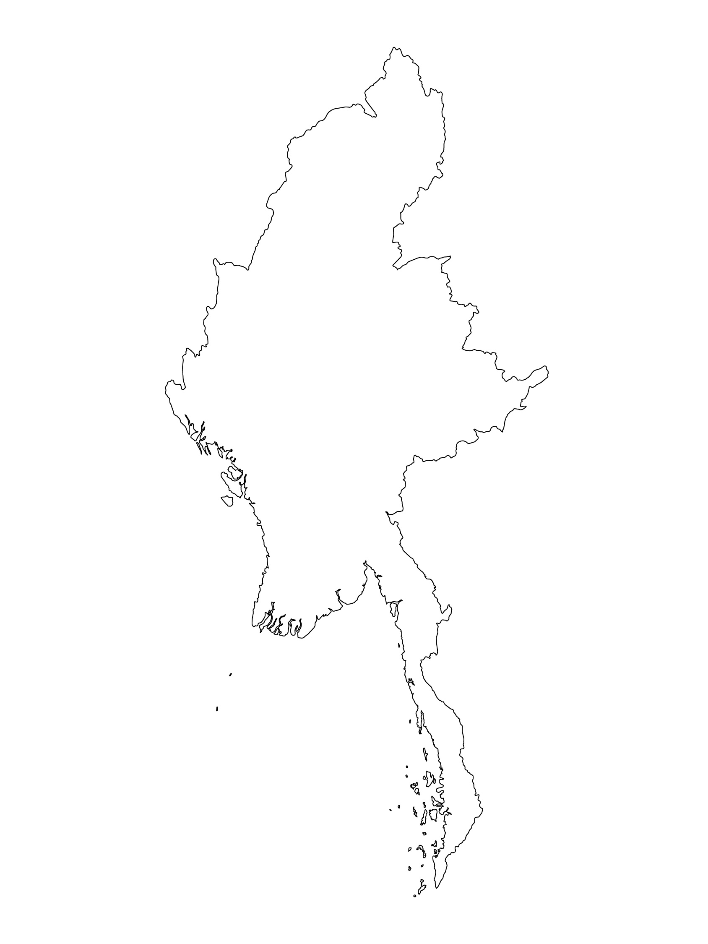
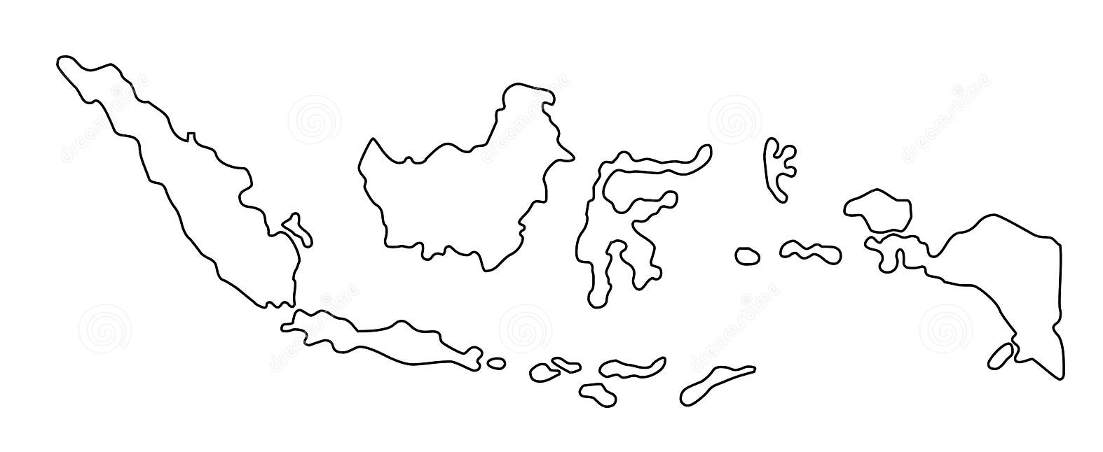
Examples from the Region
[COUNTRY NAME]
Add key presentation sentence about a specific program/project using Pillar 1
Add name of organisations
Add key message / numbers
[ COUNTRY NAME]
Add key presentation sentence about a specific program/project using Pillar 1
Add name of organisations
Add key message / numbers
[ COUNTRY NAME]
Add key presentation sentence about a specific program/project using Pillar 1
Add name of organisations
Add key message / numbers
Notes:
Depending on the time you have for facilitation, consider adding here examples from the Region/ Country/ Response, of programming that meets the standards.
This could be a draft slide that you could update or remove if necessary.
For each example, you could add:
A short, concise, key presentation sentence about the specific program/project using Pillar 1
Add the name of organisations and partners involved
Add practical lessons learnt, key actions, message or numbers, that will attract interest of your audience
Another option, if you have a larger facilitation span (and also depending on the audience you have), this slide can be completed in an interactive way during the session.
In that case, you could:
split the groups into 2 or 3 smaller groups,
allow 15 – 20 min for them to prepare a short presentation of an example from the Region/ Country/ Response, of programming that meets the standard
in plenary, have the groups present their examples, and discuss /compare lessons learnt out of them.
If you will be sending this presentation to the participants after the training, you can fill up this slide, to keep records of the presentations.
TIP: you can either use https://thenounproject.com/ to get map outlines like those.

Slide 8
Need more than the hard copy?
On the Alliance website
PDF version
Briefing & Implementation Pack
25-page Summary
E-course
YouTube videos
A gallery of illustrated Standards
👉 www.AllianceCPHA.org
On the Humanitarian Standards Partnership website
Online, interactive version
HSP App for mobile phones and tablets
👉 www.HumanitarianStandardsPartnership.org
Notes:
[Facilitators - if you can project from the internet, then we suggest you navigate people there and show them]
HSP:
1. Online handbook
2. The Humanitarian Standards Partnership App
– It is the 2nd most popular app on that site after Sphere
CPMS page:
1. Interactive handbook – our greatest resource
2. A Summary: At just 32 pages, it means that it is very topline but can be used to introduce the idea of minimum standards or start child protection discussions with government colleagues or other humanitarians without overwhelming them with the huge handbook.
Alliance website:
The PDF & all materials available can be downloaded if people want to print just portions of the CPMS, on the Alliance site
The “Introduction to CPMS” Briefing Pack contains this PPT and facilitation notes, plus the 2 page Introduction handout.
A gallery of illustrated Standards
Discover our free CPMS e-course with a range of modules
Videos on the Alliance Youtube channel
ASK: What should our next steps as a team/agency/individual be?
(i.e. you might schedule a longer meeting to digest the changes and create a plan; or ask colleagues to present certain new/revised standards and their implications for the programme; or set up a training or ask Senior Management for a meeting to discuss accountability to children, etc)
[Facilitators - Printed copies – there is a small stockpile of the Handbook and Summary that the global Alliance has in Geneva; however, countries and regions are encouraged to print & manage their own copies locally. Usually, this would be done through the inter-agency Coordination structure. On request, the Alliance can share a print-ready PDF.]
Thank you so much for coming together and starting to explore the CPMS. I will follow up on the next steps we discussed. And that’s the key – the CPMS is a gift that just keeps on giving every time you open it!

