Slide 1
The Minimum Standards for Child Protection in Humanitarian Action
CPMS
SLIDE DECK
Notes:
Facilitators:
This briefing is for any potential user of the CPMS. It is geared primarily toward child protection staff, so consider broadening some questions or providing more detail, if colleagues from other sectors join you.
It is assumed that the group is about 20 people and that everyone in the room knows each other (perhaps colleagues from your agency or the CP coordination group). if not, add 5 minutes for quick introductions.
PREPARE: a flipchart with the objectives of the session
By the end of the session, participants will be able to:
Describe the content of Standard 15
Explain & Share its key messages
Demonstrate how & why to use the handbook
NOTE: if you have already done a Session on Pillar(s), Principles or other Standard(s), skip slide 2 & 8
TIP: Slides are animated -> for each click you’ll make, some few words, a title or an image will appear on the slide.
Read the corresponding notes from the facilitators notes, before showing the following content, so participants have time to process what you say, and read each point.

Slide 2
Aim of the Standards
Benchmark for CPHA.
Collaborative, inter-agency tool
Links with Core Humanitarian Standard
Contextualisation for local ownership
Purpose:
quality and accountability
impact for children’s protection and well-being
Notes:
Donors, local governments, colleagues in other sectors and our beneficiaries themselves want to know what we are doing and why. The CPMS are our benchmark. CPMS are the key way to operationalise or make real children's rights in the practice of humanitarian response.
They are a collaborative, inter-agency tool, that links with other initiatives, such as the Core Humanitarian Standard, INSPIRE and the Humanitarian Inclusion Standards
Wherever relevant, the CPMS align with INSPIRE’s 7 strategies to end violence against children – initiative’s icons are actually scattered through the text. In addition, the Core Humanitarian Standard on Quality and Accountability is highlighted in the Introduction and resonates throughout the handbook.
Contextualisation is encouraged and can create ownership of the standards at every level. It builds a deeper understanding of child protection in the specific context for a wide range of actors. Watch the short video about the process on the Alliance youtube channel. National coordination groups are encouraged to adapt the CPMS. Please raise it with colleagues locally and then seek the guidance of the global CPMS team.
BOX: The CPMS aim at improving the quality and accountability of our programing and increasing impact for children’s protection and well-being in humanitarian action (internal displacement and refugee contexts), by establishing common principles, evidence, prevention and goals to achieve. They provide a synthesis of good practice and learning to date.

Slide 3
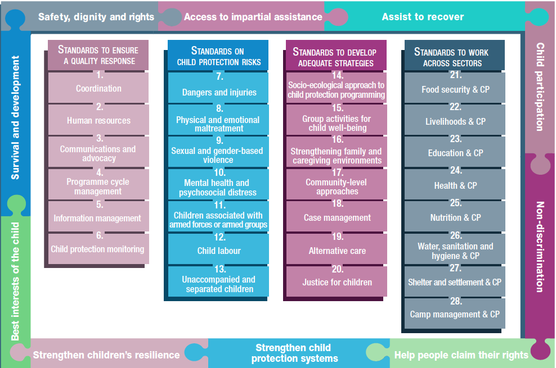
Overview
Notes:
This is an overview of the CPMS structure: there are 28 Standards across 4 pillars and 10 CPHA principles threaded throughout.
You can find this overview on the back of the CPMS handbook or in the online handbook; it’s a practical way of locating quickly a specific topic.
This presentation focuses on Standard 15: Group activities for child well-being

Slide 4
General introduction to Standard 15
Key strategies, approaches and interventions
Prevention and response to child protection risks
Group-based, planned activities
Safe, inclusive, contextually and age-appropriate approaches promoting protection
Realistic measurable objectives
Can you give examples of group activities?
Notes:
This Standard is part of the third Pillar of Standards related to developing adequate strategies, approaches and interventions for preventing and responding to the child protection risks outlined in Pillar 2. It is structured around the socio-ecological model and also links with the INSPIRE package, where appropriate, and builds on their evidence-based strategies for preventing violence against children. Hence the ICON in the corner. The INSPIRE package has a similar goal: evidence-based strategies for preventing violence against children. More info about INSPIRE strategies on: http://inspire-strategies.org/
This Standard promotes (1) protection, (2) well-being and (3) learning
(1) Such activities can promote protection by (a) identifying children who are vulnerable or who are experiencing abuse, neglect, exploitation or violence and (b) supporting appropriate referrals – please see St 8, 9, 11, 12, 13 to dig further on other protection concerns
(2) Theses activities seek to impact children’s well-being, enhance their resilience and reduce their stress. Additionally to the participation of children in the design, implementation and monitoring of activities, the activities should look at promoting children ‘s participation, and empowerment (linked with the Agency objective in the well-being definition – please see St 10 to dig further on well-being, especially slide 5 of Standard 10 slide deck)
(3) It aims to ensure that opportunities for children to come together in a predictable and stimulating environment to be safe, to learn, to express themselves, to make connections and to feel supported are delivered in safe, inclusive, contextually and age-appropriate approaches - please see St 23 to dig further on the education/learning component
It is also important to emphasize the importance of ensuring realistic measurable objective(s) are set up for these type of activities. There are different types of resilience capacities ( coping / adapting and transforming); according to the context, the age of the children, it is important to clarify what type of resilience is being supported, in order to set up realistic objective(s) and ensure the set up and type of activities is promoting the specific level of resilience needed in a specific context.
Icons: Links with INSPIRE strategies on Education and life skills + Safe environments
This standard replace the previous Child Friendly Spaces standard: there was a feeling over-reliance on this one type of intervention, and instead it is grouped under “Group activities for child well-being” which also explores mobile programming, links to skills training, and other regular and consistent opportunities for improving children’s protection.
Discussion Prompt: Can you give examples of group activities?
->Group activities for child well-being can include:
Non-formal education;
Structured and free play;
Arts and crafts;
Sports;
Life skills;
Resilience and life skills programmes;
Leadership training for adolescents; and
Parenting and support groups that strengthen families’ and communities’ child protection capacities.
->They can take place in a fixed space, commonly referred to as a ‘child-friendly space’ or a ‘safe space’, or also be mobile, facilitated by a specific group of animators in varied, rotating locations, in contexts with (a) highly mobile, scattered or displaced populations or (b) limited access due to security concerns

Slide 5
“Children are supported through access to group-based, planned activities that (a) promote protection, well-being and learning and (b) are delivered in safe, inclusive, contextually and age-appropriate approaches.”
Sustainable, community-led initiatives
Needs-assessment
Consultation & Participation
Potential for working across sectors
What about the sustainability of group activities?
Notes:
Standard 15 states: “Children are supported through access to group-based, planned activities that (a) promote protection, well-being and learning and (b) are delivered in safe, inclusive, contextually and age-appropriate approaches.”
It is important to identify, support and strengthen existing spaces, services and activities before developing additional group activities. Once organized, we should plan to transition into more sustainable, community-led initiatives. Where they are needed, design group activities based on an assessment of needs and protection risks in order to decide where, how, when and by whom the activities will be conducted; what the objectives are; and whether specific facilities are required.
Assessment should be conducted in consultation with children & communities to identify barriers to access, and activities should give all children the opportunity to participate in activities adapted to their particular needs, interests, skills, capacities and characteristics. It is important to assess the needs in a participative and contextual way to clarify the specific objective(s) we have for supporting group activities (linked with IA Well being definition; basic needs, safety and security, relationships with family and others, agency)
I.e: schedules with consideration for school-related, religious and other activities; access for children with disabilities; approach for child labourers or children who are parents, tailored activities for adolescents, early childhood activities for 0 – 2 years old with children’s parents/caregivers…
Group activities can also be opportunities to work with other sectors:
early childhood development/other sector staff with specialised knowledge to implement group activities for children in this age range
other sectors who may offer life skills, such as education or livelihoods.
community-level systems and groups such as women’s groups and child protection committees
education sectors to develop group activities that complement non-formal and formal education
health and water, sanitation and hygiene actors, during infectious disease outbreaks, to adapt activities for (a) children who are in treatment, quarantine or isolation and/or (b) for children whose caregivers have been admitted to a care facility
other sectors (such as health; nutrition; and water, sanitation and hygiene) to provide integrated or mainstreamed multisectoral services and prevent duplication
Discussion Prompt: What about the sustainability of group activities? Are we (or is the community) always looking at sustaining group activities set up in a humanitarian context ? When should we? When shouldn’t we?
-> the issue of sustainability of activities put in place depends a lot of the specific contexts & the objective(s) we set up for the group activities (linked with the needs expressed and identified).
For example, these activities can be set up to replace temporarily school activities which can be stopped during emergencies (not looking for sustainability on a long term)
Or, if we look at proposing activities to support child marriage prevention and response (life skills and CP support), it could be interesting to sustain them on the long run, or to be taken over by other actors …

Slide 6
Considerations for group activities
Mobility & Outreach
Culturally appropriate recreational materials
Programme of activities
M&E system
Service mapping and referral pathways
Notes:
Group activities may also be mobile, facilitated by a specific group of animators in varied, rotating locations. The locations are identified ahead of time based on an assessment that they are safe and accessible to children of different genders, ages, disabilities and other relevant aspects of diversity. We should conduct outreach to identify and encourage the participation of children who may generally be excluded from group activities. In some settings children who are refugees, internally displaced or migrants may be highly mobile: group activities might then provide temporary and short-term shelter and accommodation, information on services available in the location, internet connectivity and basic psychological first aid [→ the refugee icon]
We should identify available safe, local and culturally appropriate recreational materials with a low environmental impact.
A monitoring and evaluation system should includes the meaningful participation of children, families and communities
Programme of activities should be Inclusive; Accessible; Tailored to their needs and preferences; Skill-enhancing; Resilience-building and Compatible with education or other essential services, to involve children of different ages, genders, disabilities and other relevant diversity factors and reduce barriers to access. Provide separated spaces/time slots and tailored activities for each group of children, taking into account their specific needs [→ the adolescent & ECD icons]
Collaboration with the child protection coordination group(s) to ensure that up-to-date service mapping and referral pathways are available, in a accessible, child-friendly way is needed [→ the case management icon]

Slide 7
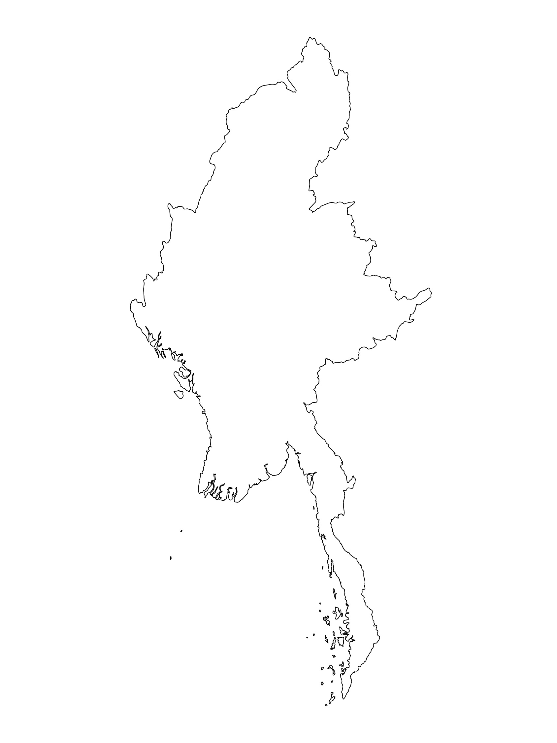
Examples from the Region
[COUNTRY NAME]
Add key presentation sentence about a specific program/project using Standard 15
Add name of organisations
Add key message / numbers
[ COUNTRY NAME]
Add key presentation sentence about a specific program/project using Standard 15
Add name of organisations
Add key message / numbers
[ COUNTRY NAME]
Add key presentation sentence about a specific program/project using Standard 15
Add name of organisations
Add key message / numbers
Notes:
Depending on the time you have for facilitation, consider adding here examples from the Region/ Country/ Response, of programming that meets the standards.
This could be a draft slide that you could update or remove if necessary.
For each example, you could add:
A short, concise, key presentation sentence about the specific program/project using Standard 15
Add the name of organisations and partners involved
Add practical lessons learnt, key actions, message or numbers, that will attract interest of your audience
Another option, if you have longer (and also depending on the audience you have), this slide can be completed in an interactive way during the session.
In that case, you could:
split the groups into 2 or 3 smaller groups,
allow 15 – 20 min for them to prepare a short presentation of an example from the Region/ Country/ Response, of programming that meets the standard
in plenary, have the groups present their examples, and discuss /compare lessons learnt out of them.
If you will be sending this presentation to the participants after the training, you can fill up this slide, to keep records of the presentations.
TIP: you can use https://thenounproject.com/ to get map outlines like those.

Slide 8
Need more than the hard copy?
On the Alliance website
PDF version
Briefing & Implementation Pack
25-page Summary
E-course
YouTube videos
A gallery of illustrated Standards
👉 www.AllianceCPHA.org
On the Humanitarian Standards Partnership website
Online, interactive version
HSP App for mobile phones and tablets
👉 www.HumanitarianStandardsPartnership.org
Notes:
[Facilitators - if you can project from the internet, then we suggest you navigate people there and show them]
HSP:
1. Online handbook
2. The Humanitarian Standards Partnership App
– It is the 2nd most popular app on that site after Sphere
CPMS page:
1. Interactive handbook – our greatest resource
2. A Summary: At just 32 pages, it means that it I CPHA topline but can be used to introduce the idea of minimum standards or start child protection discussions with government colleagues or other humanitarians without overwhelming them with the huge handbook.
Alliance website:
The PDF & all materials available can be downloaded if people want to print just portions of the CPMS, on the Alliance site
The “Introduction to CPMS” Briefing Pack contains this PPT and facilitation notes, plus the 2 page Introduction handout.
A gallery of illustrated Standards
Discover our free CPMS e-course with a range of modules
Videos on the Alliance Youtube channel
ASK: What should our next steps as a team/agency/individual be?
(i.e. you might schedule a longer meeting to digest the changes and create a plan; or ask colleagues to present certain new/revised standards and their implications for the programme; or set up a training or ask Senior Management for a meeting to discuss accountability to children, etc)
[Facilitators - Printed copies – there is a small stockpile of the Handbook and Summary that the global Alliance has in Geneva; however, countries and regions are encouraged to print & manage their own copies locally. Usually, this would be done through the inter-agency Coordination structure. On request, the Alliance can share a print-ready PDF.]
Thank you so much for coming together and starting to explore the CPMS. I will follow up on the next steps we discussed. And that’s the key – the CPMS is a gift that just keeps on giving every time you open it!

